Slide 1
Mod arithmetic
CMSC250

Slide 2
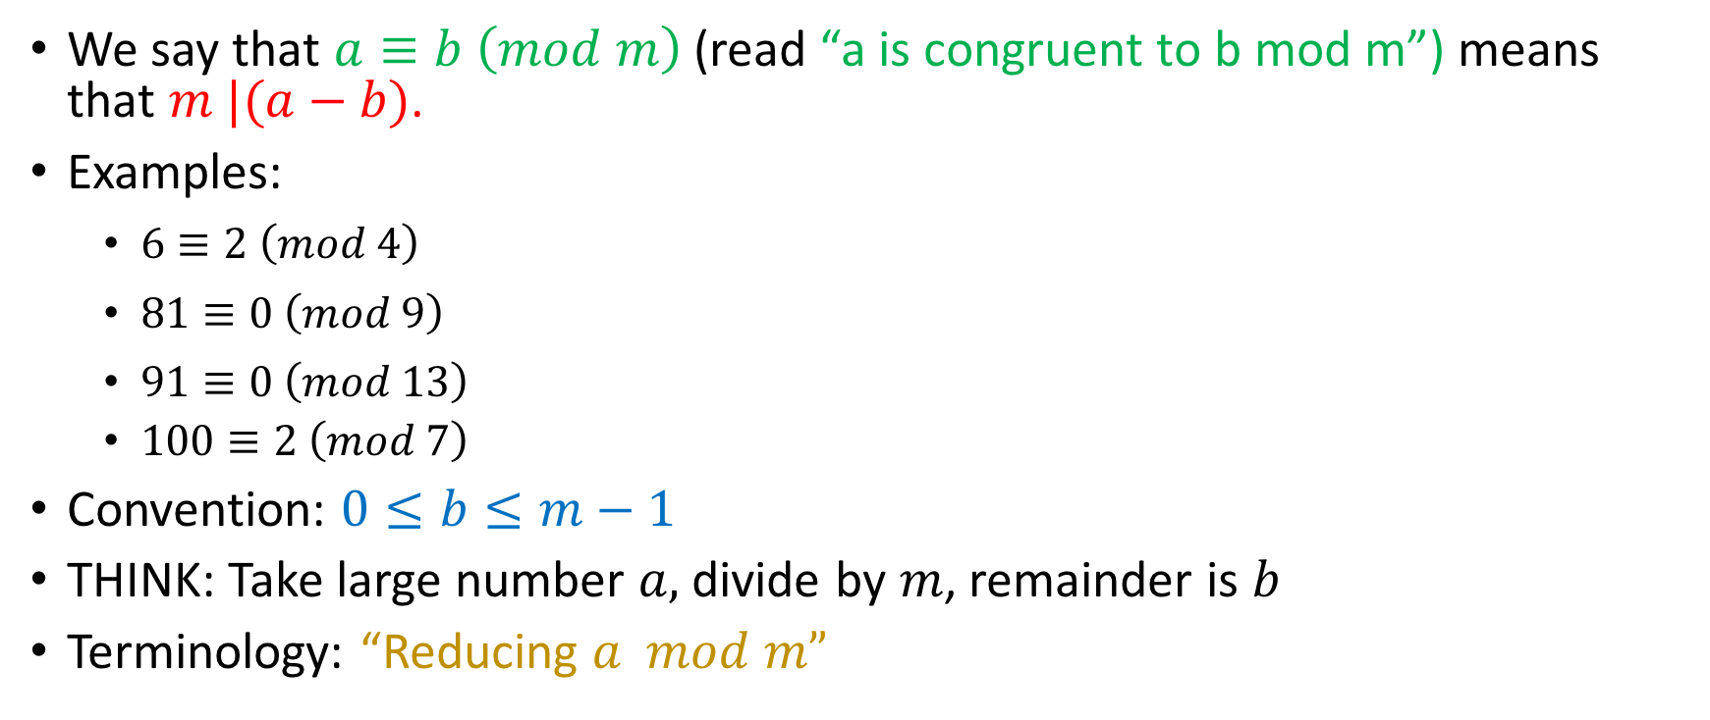
Modular Arithmetic

Slide 3

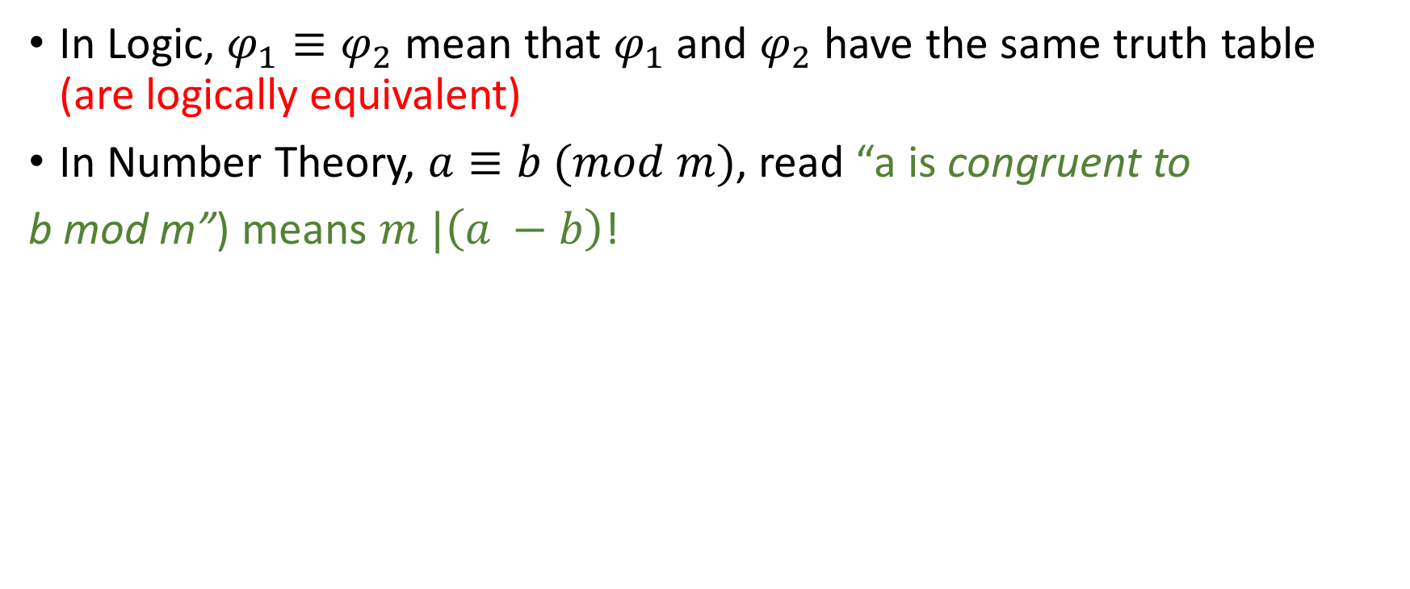

Slide 4
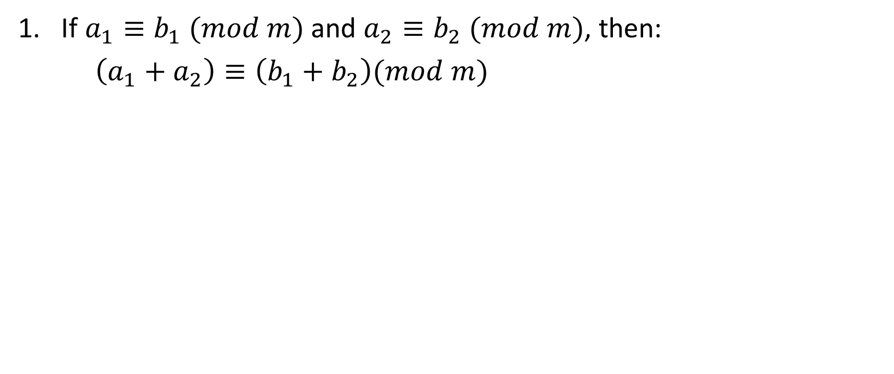
Properties of congruence

Slide 5
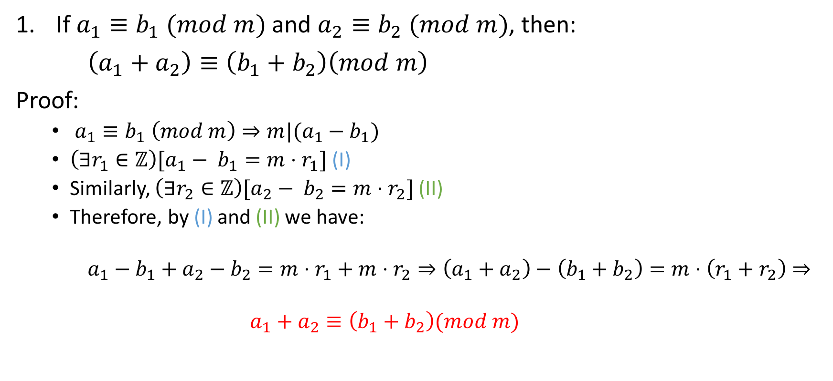
Properties of congruence

Slide 6
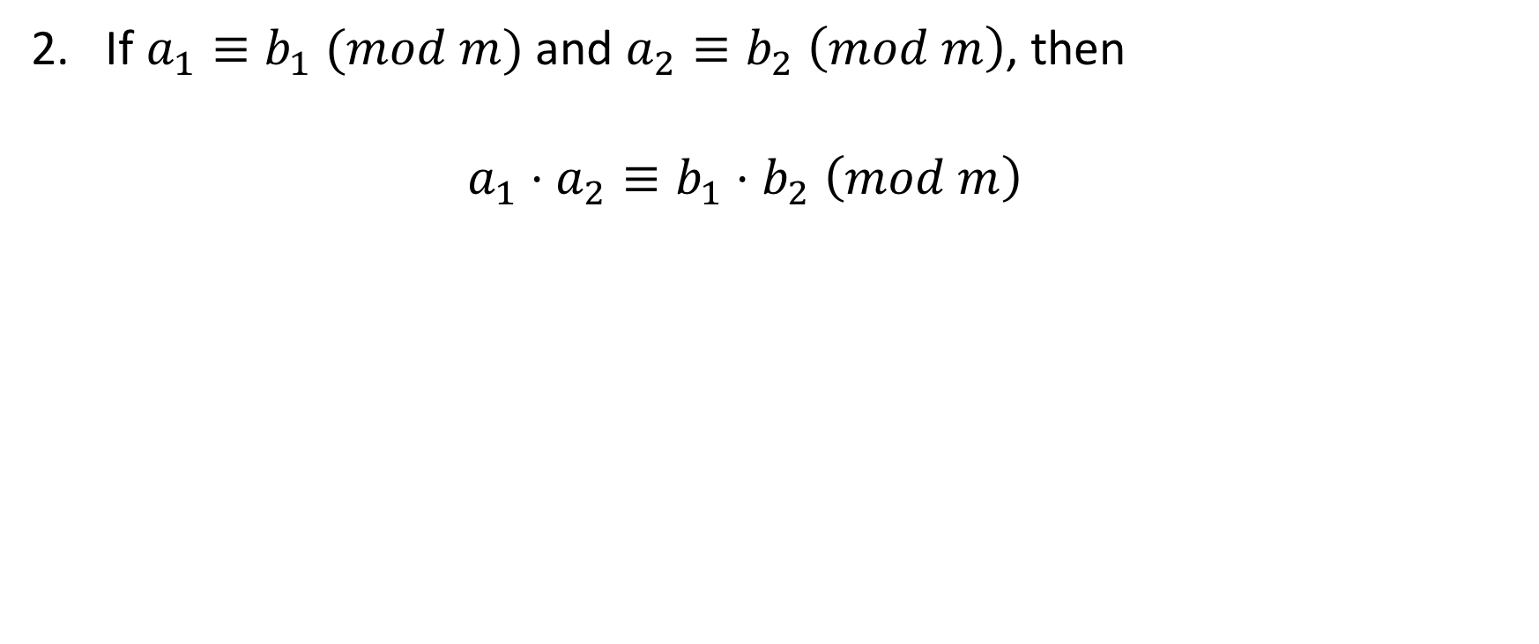
Properties of congruence

Slide 7
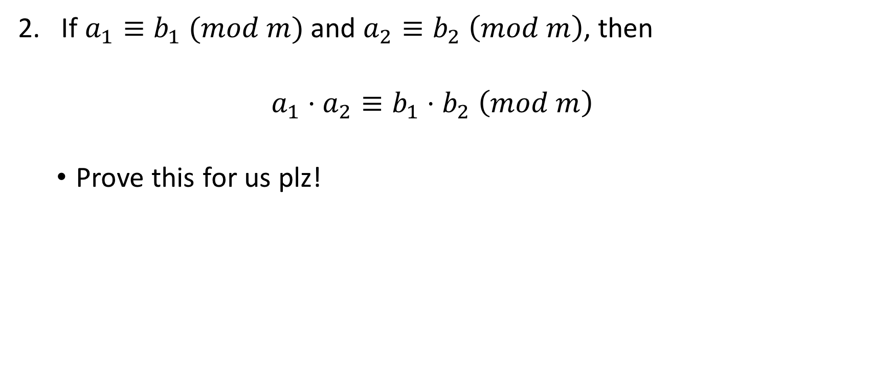
Properties of congruence

Slide 8
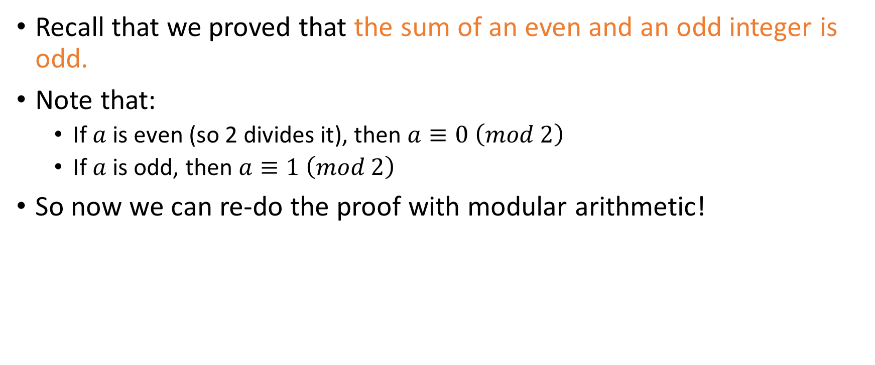
First proof revisited

Slide 9
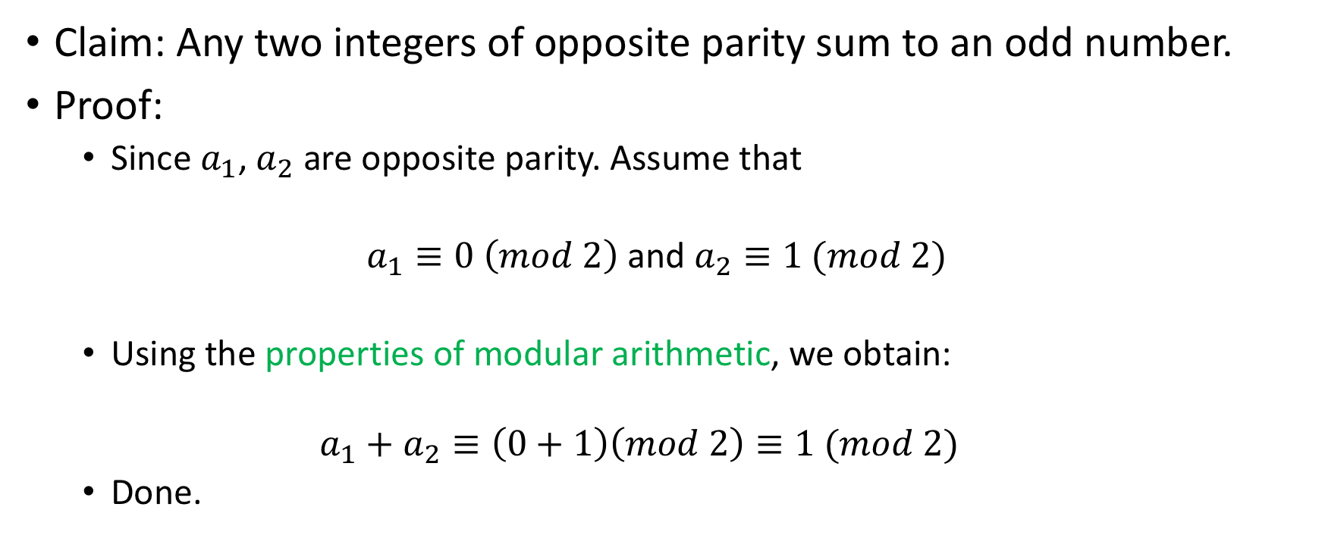
Proof with modular arithmetic

Slide 10
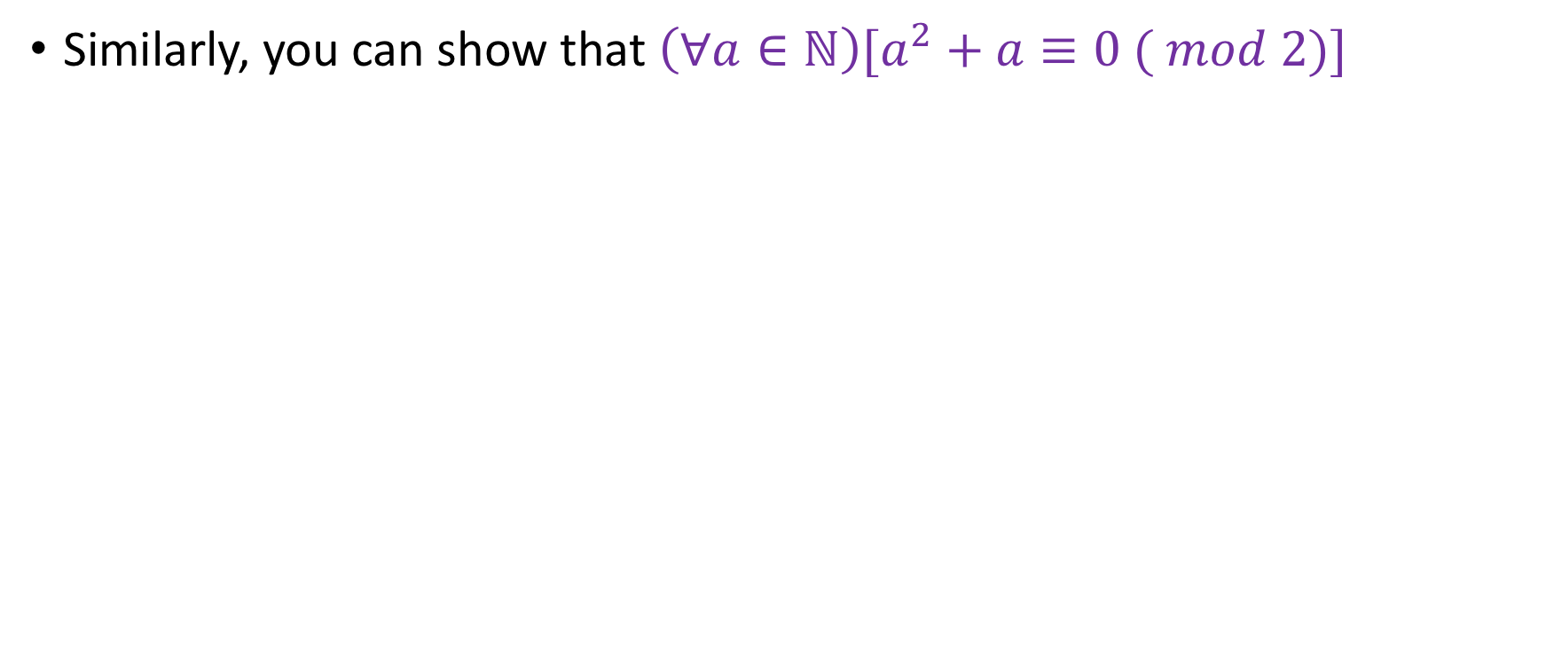
More proofs

Slide 11
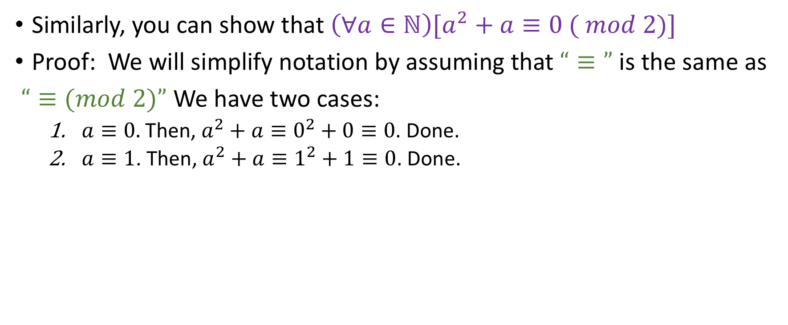
More proofs

Slide 12
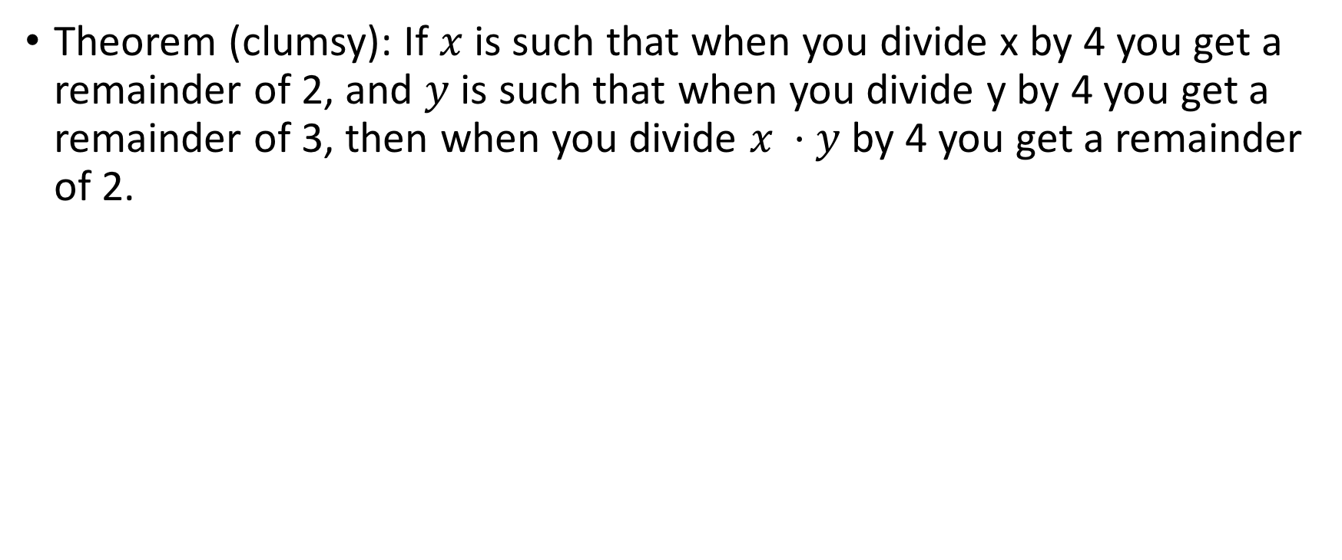
Advantages of this notation

Slide 13
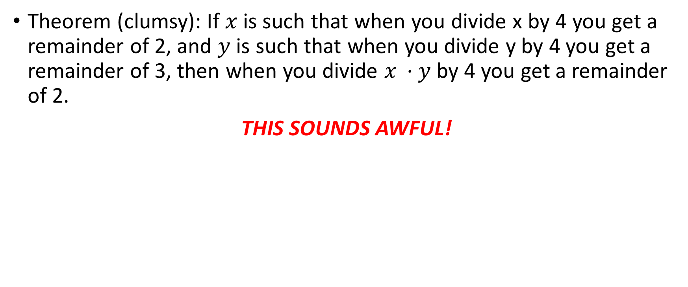
Advantages of this notation

Slide 14
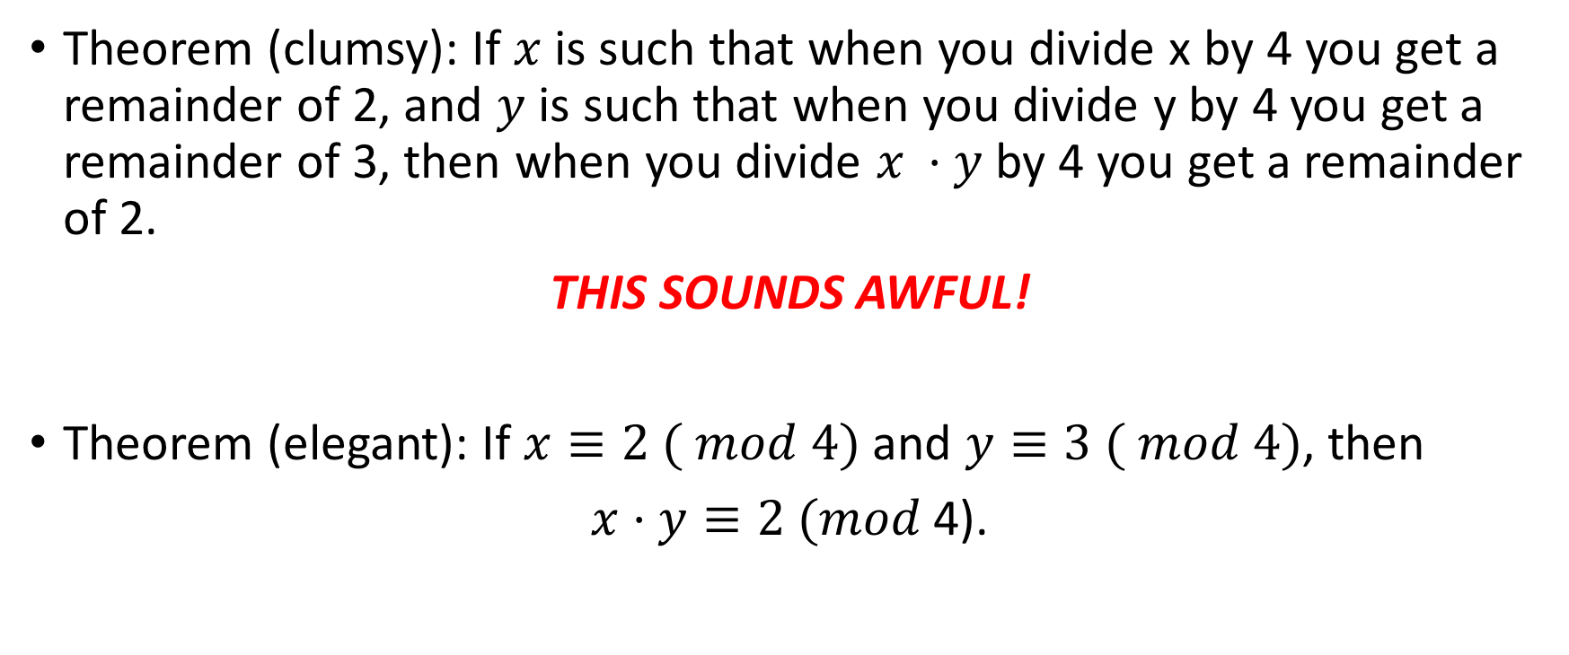
Advantages of this notation

Slide 15
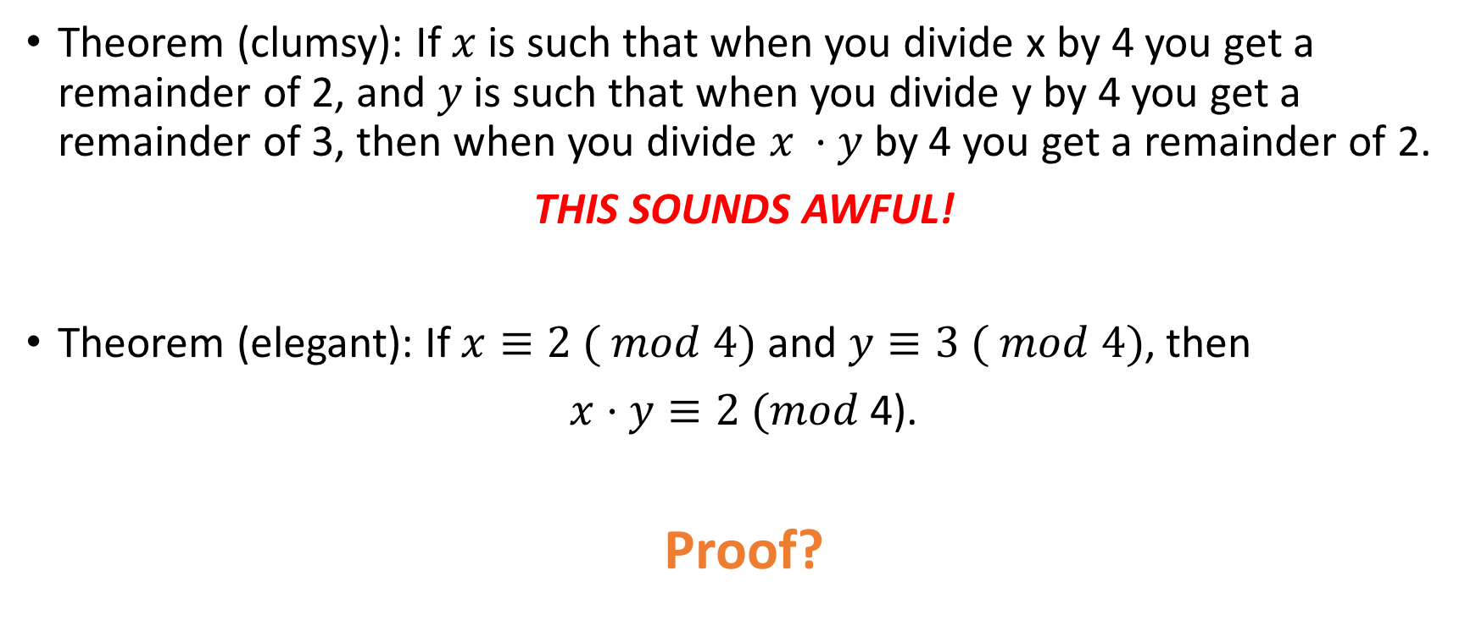
Advantages of this notation

Slide 16
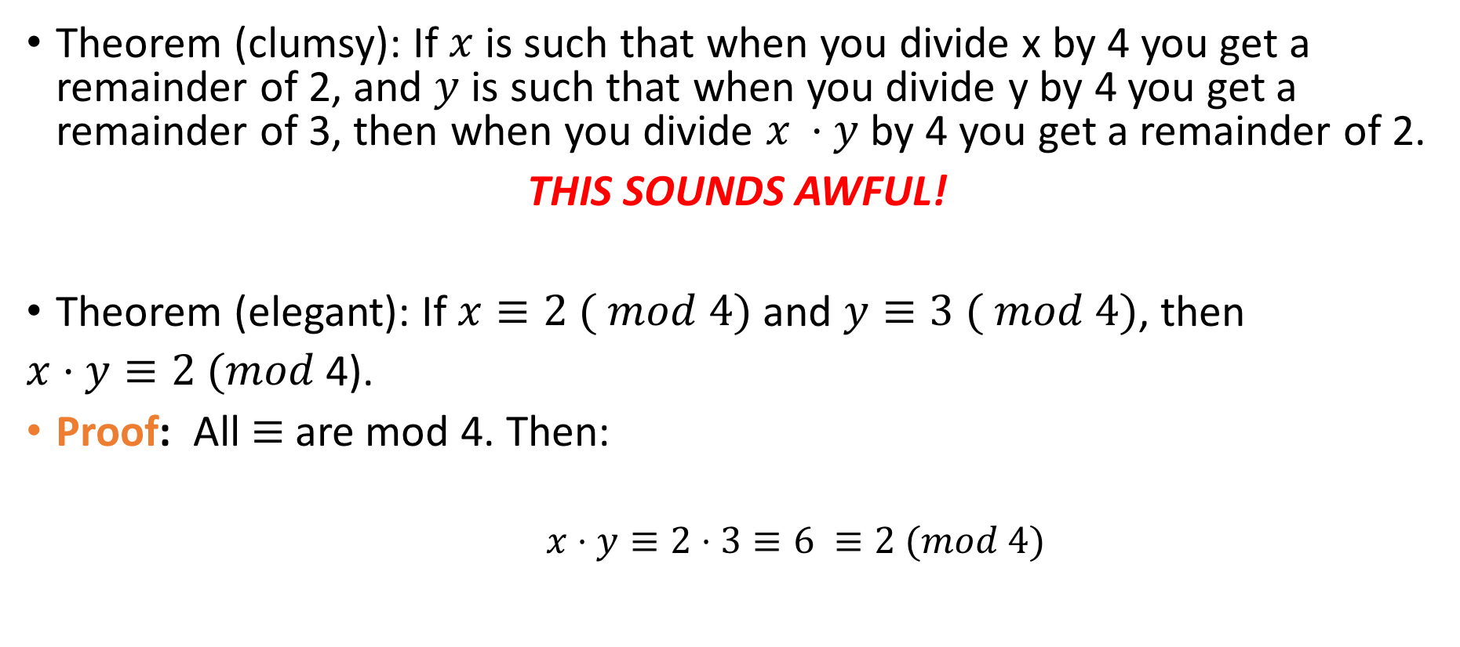
Advantages of this notation

Slide 17
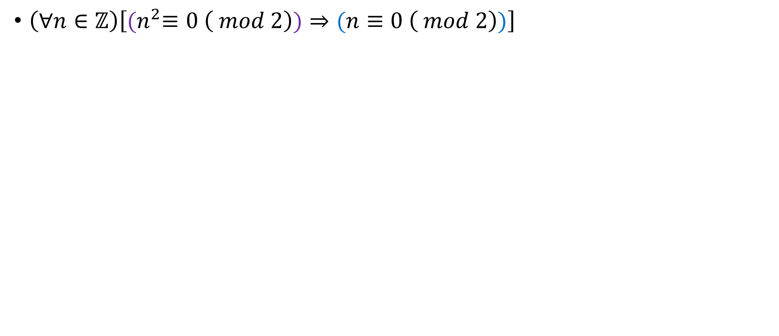
Simplifying proofs.
Notes:
Do it via parity first on paper, and then present the half line mod solution

Slide 18
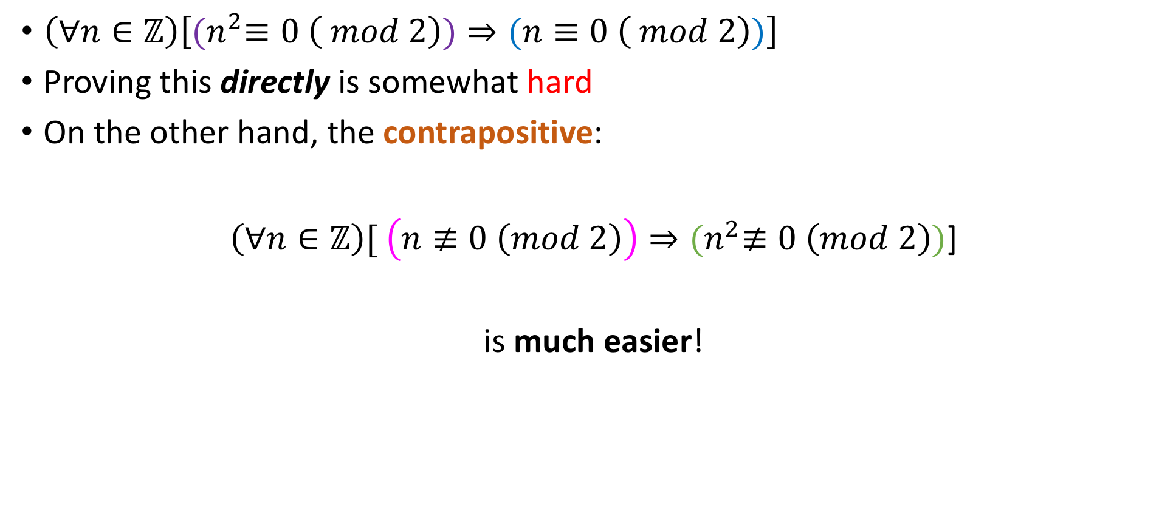
Simplifying proofs.
Notes:
Do it via parity first on paper, and then present the half line mod solution

Slide 19
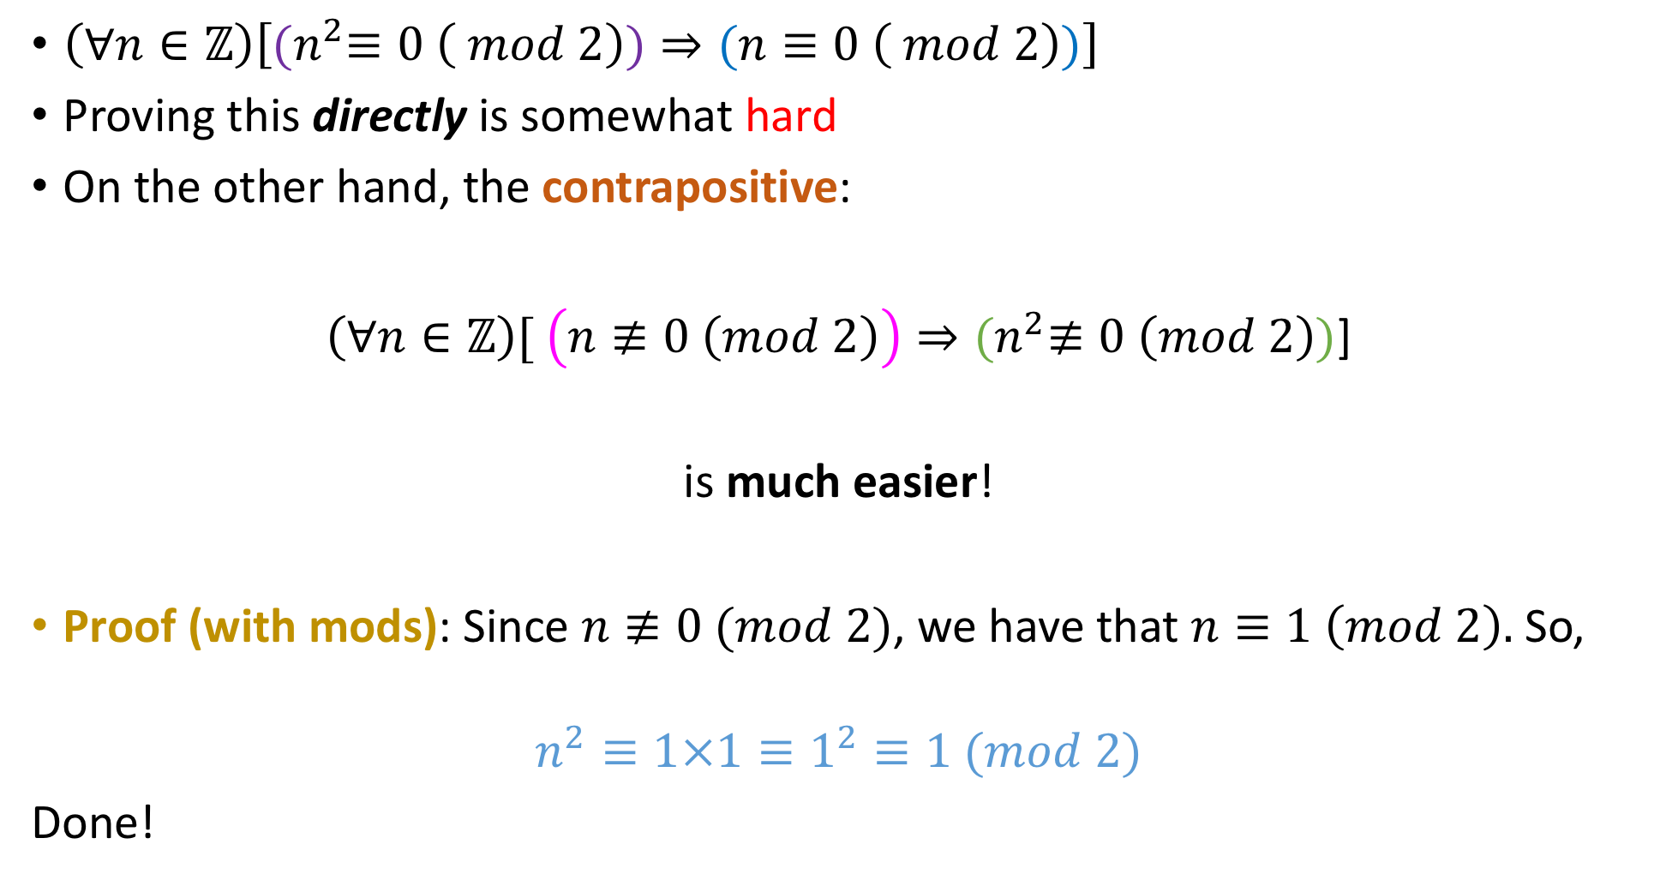
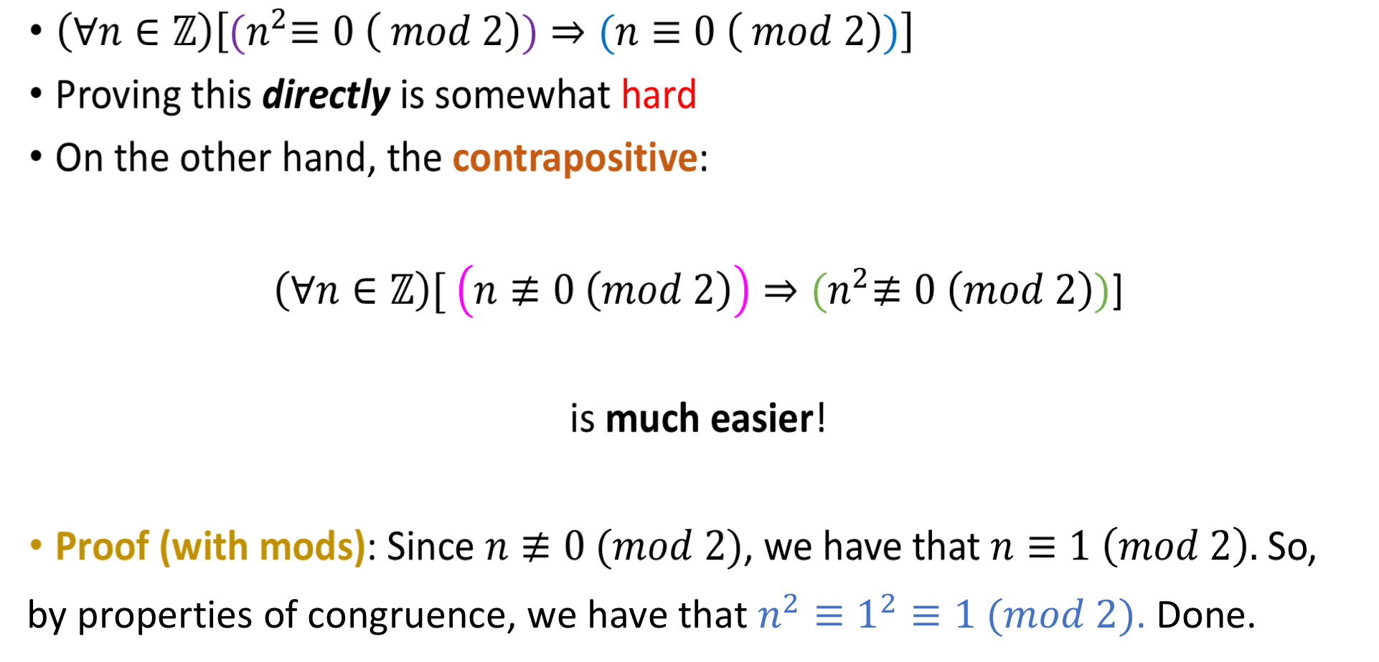
Simplifying proofs.
by properties of congruence, we have that $n^{2}≡1^{2}≡1 (mod 2)$. Done.
Notes:
Do it via parity first on paper, and then present the half line mod solution

Slide 20

Simplifying proofs.
by properties of congruence, we have that $n^{2}≡1^{2}≡1 (mod 2)$. Done.
Notes:
Do it via parity first on paper, and then present the half line mod solution

Slide 21
Optional material: Algorithms on divisibility 1. Modular Exponentiation (Repeated Squaring) 2. Greatest Common Divisor (GCD)

Slide 22
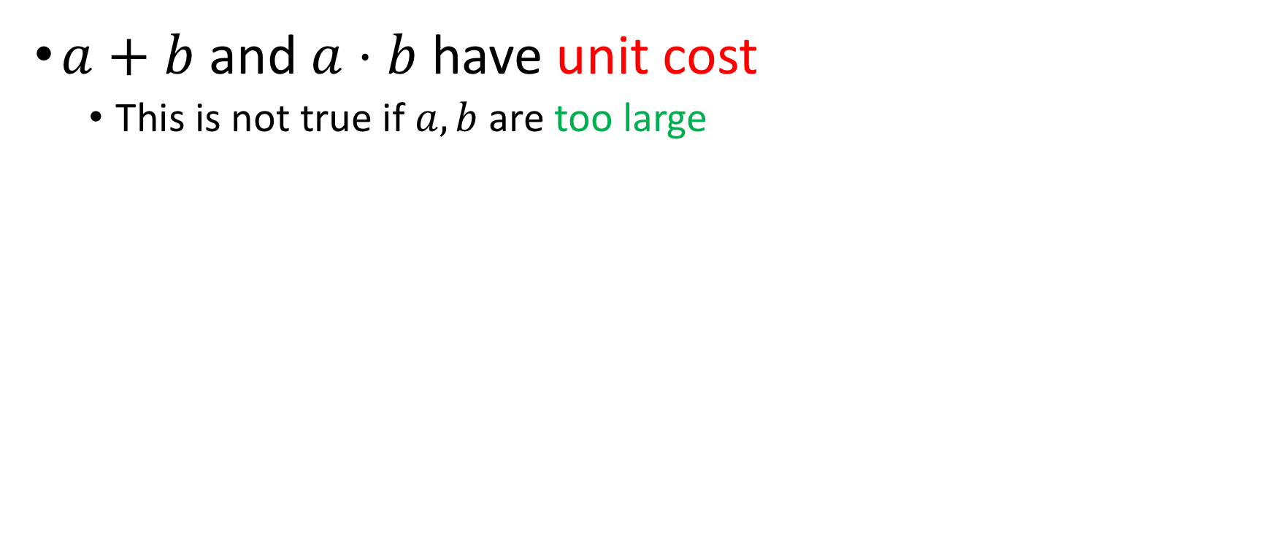
Basic assumptions
$a+b$ and $a⋅b$have unit cost
This is not true if $a,b$ are too large

Slide 23
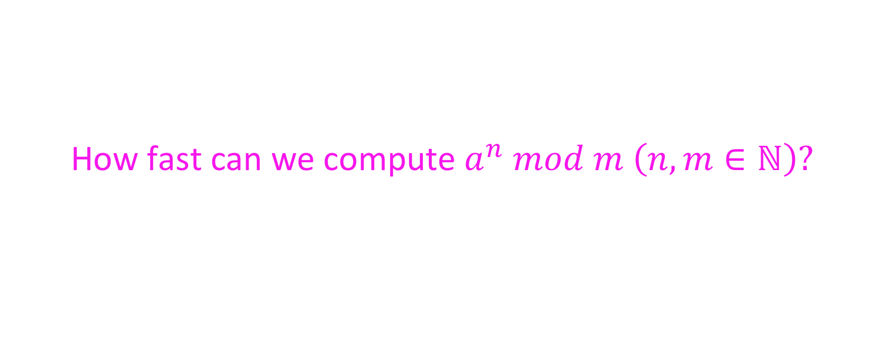
First problem
How fast can we compute $a^{n} mod m \left(n, m∈ℕ\right)?$

Slide 24
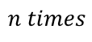
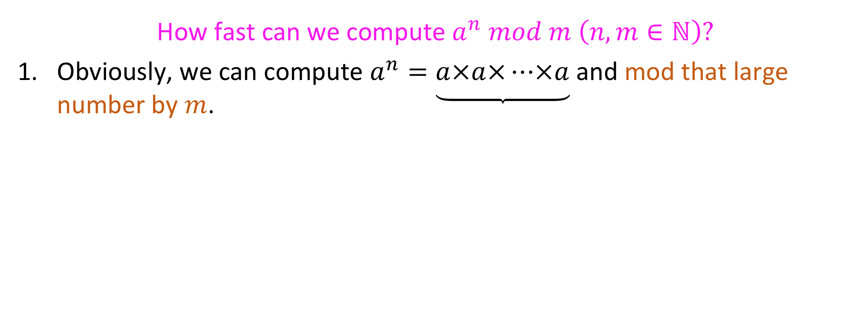
First problem
How fast can we compute $a^{n} mod m \left(n, m∈ℕ\right)?$
Obviously, we can compute $a^{n}=\underbrace{a×a×⋯×a}$ and mod that large number by $m$.
$$n times$$

Slide 25
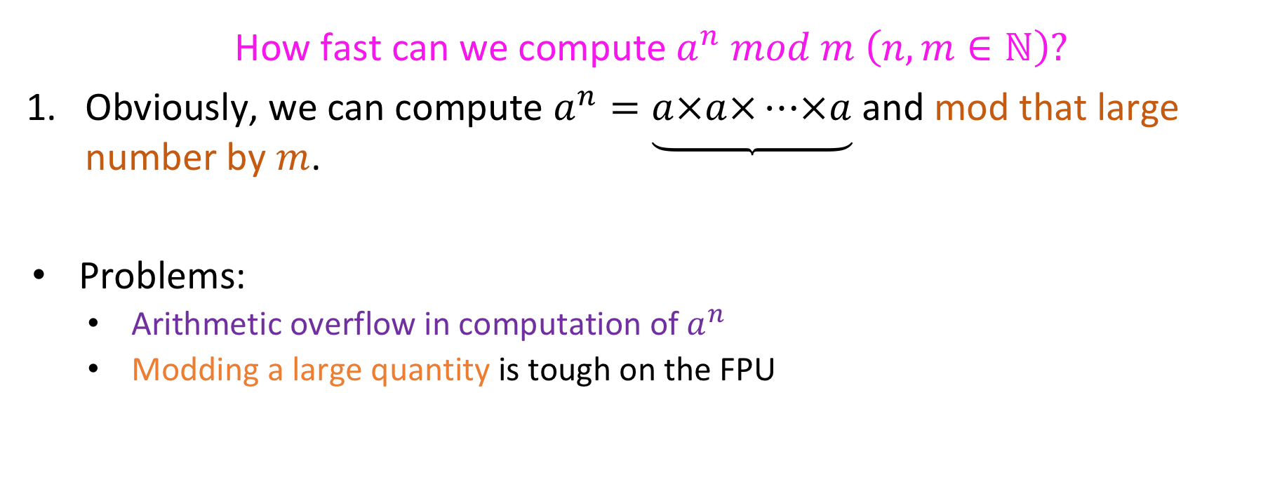
First problem
How fast can we compute $a^{n} mod m \left(n, m∈ℕ\right)?$
Obviously, we can compute $a^{n}=\underbrace{a×a×⋯×a}$ and mod that large number by $m$.
Problems:
Arithmetic overflow in computation of $a^{n}$
Modding a large quantity is tough on the FPU
$$n times$$

Slide 26
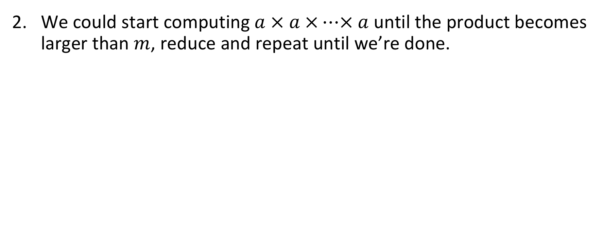
First problem, second approach
We could start computing $a × a ×⋯× a$ until the product becomes larger than $m$, reduce and repeat until we’re done.

Slide 27
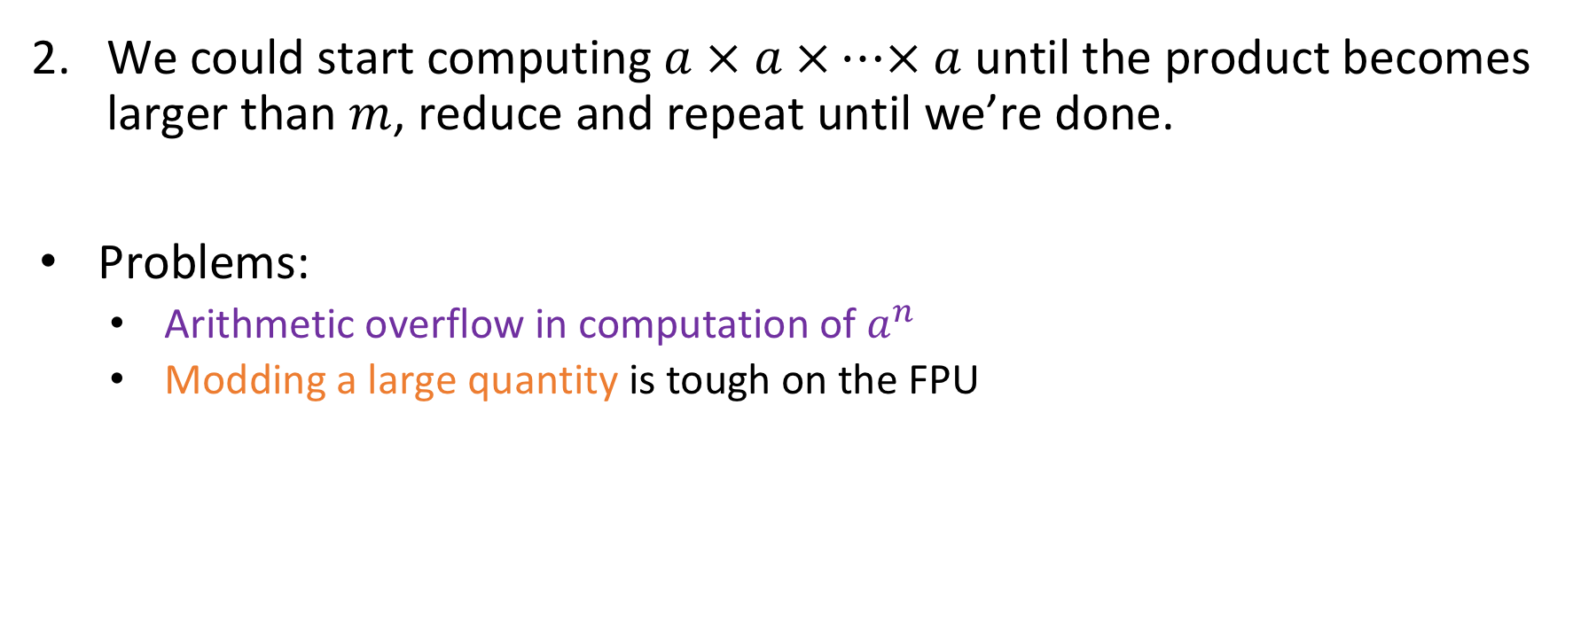
First problem, second approach
We could start computing $a × a ×⋯× a$ until the product becomes larger than $m$, reduce and repeat until we’re done.
Problems:
Arithmetic overflow in computation of $a^{n}$
Modding a large quantity is tough on the FPU

Slide 28
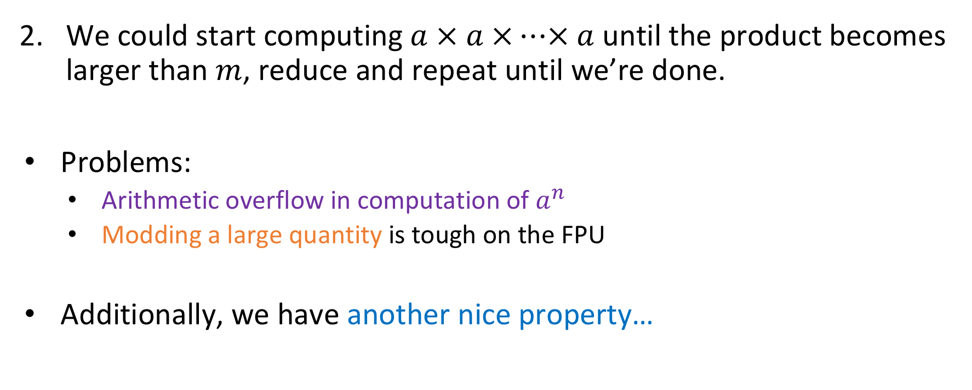
First problem, second approach
We could start computing $a × a ×⋯× a$ until the product becomes larger than $m$, reduce and repeat until we’re done.
Problems:
Arithmetic overflow in computation of $a^{n}$
Modding a large quantity is tough on the FPU
Additionally, we have another nice property…

Slide 29

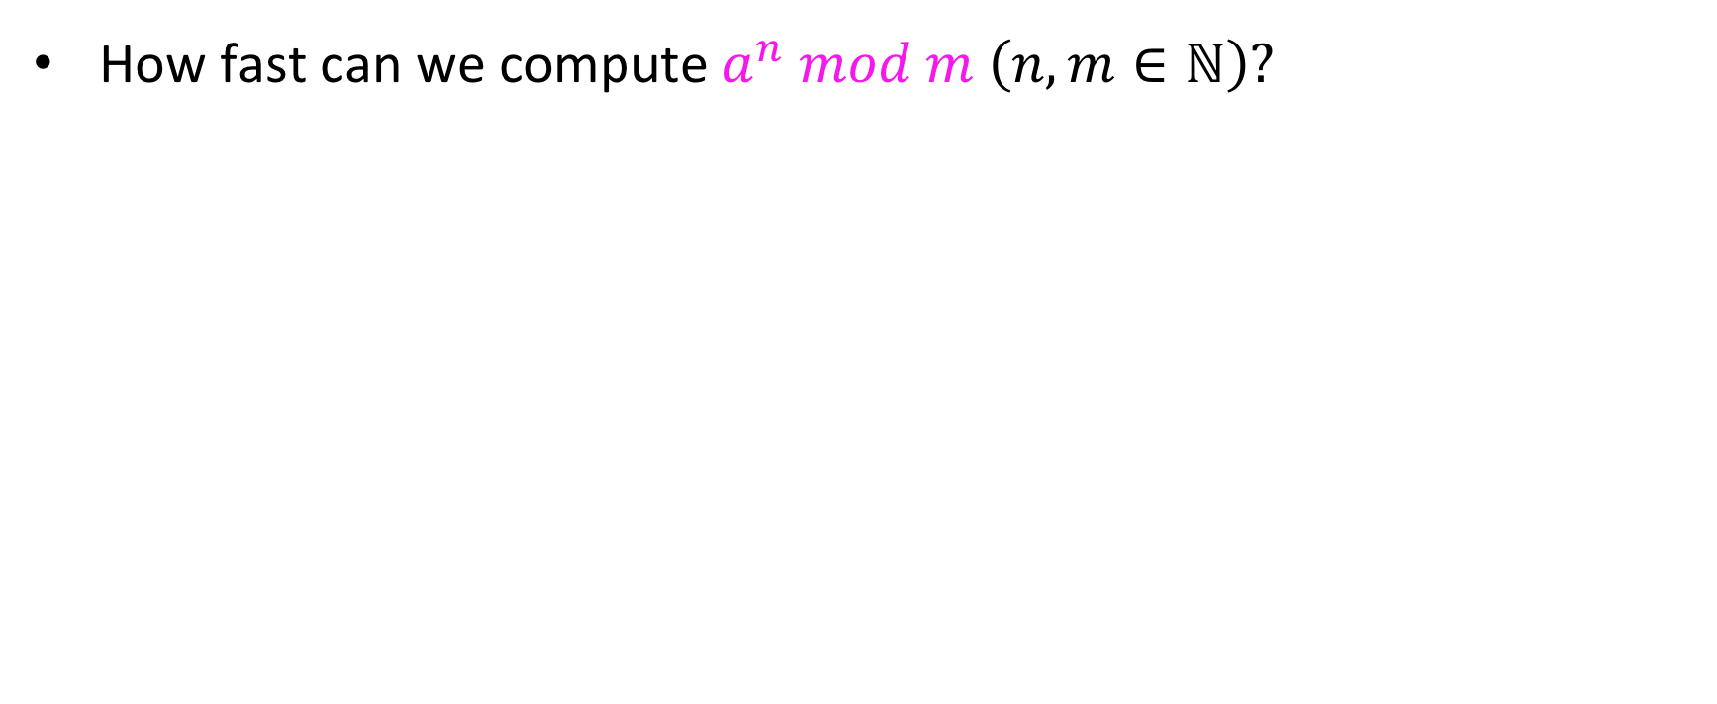


First problem
How fast can we compute $a^{n} mod m \left(n, m∈ℕ\right)?$
We always need $n$ steps
We can do it in roughly $\sqrt{n}$ steps
We can do it in roughly $logn$ steps
Something Else

Slide 30
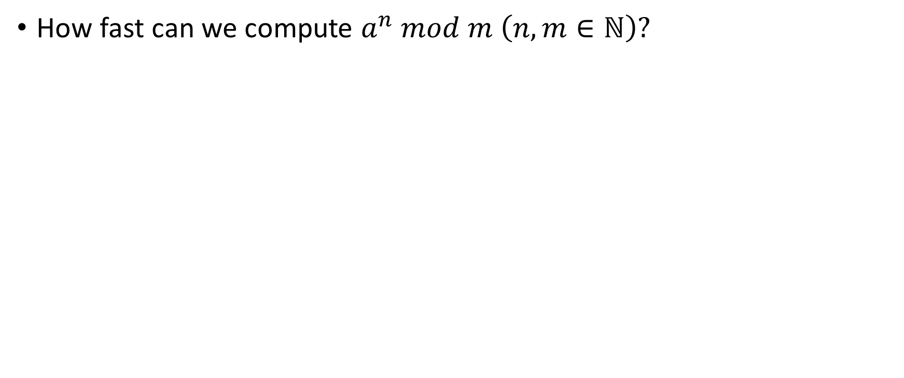

First problem
How fast can we compute $a^{n} mod m \left(n, m∈ℕ\right)?$
We always need $n$ steps
We can do it in roughly $\sqrt{n}$ steps
We can do it in roughly $logn$steps
Something Else

Slide 31
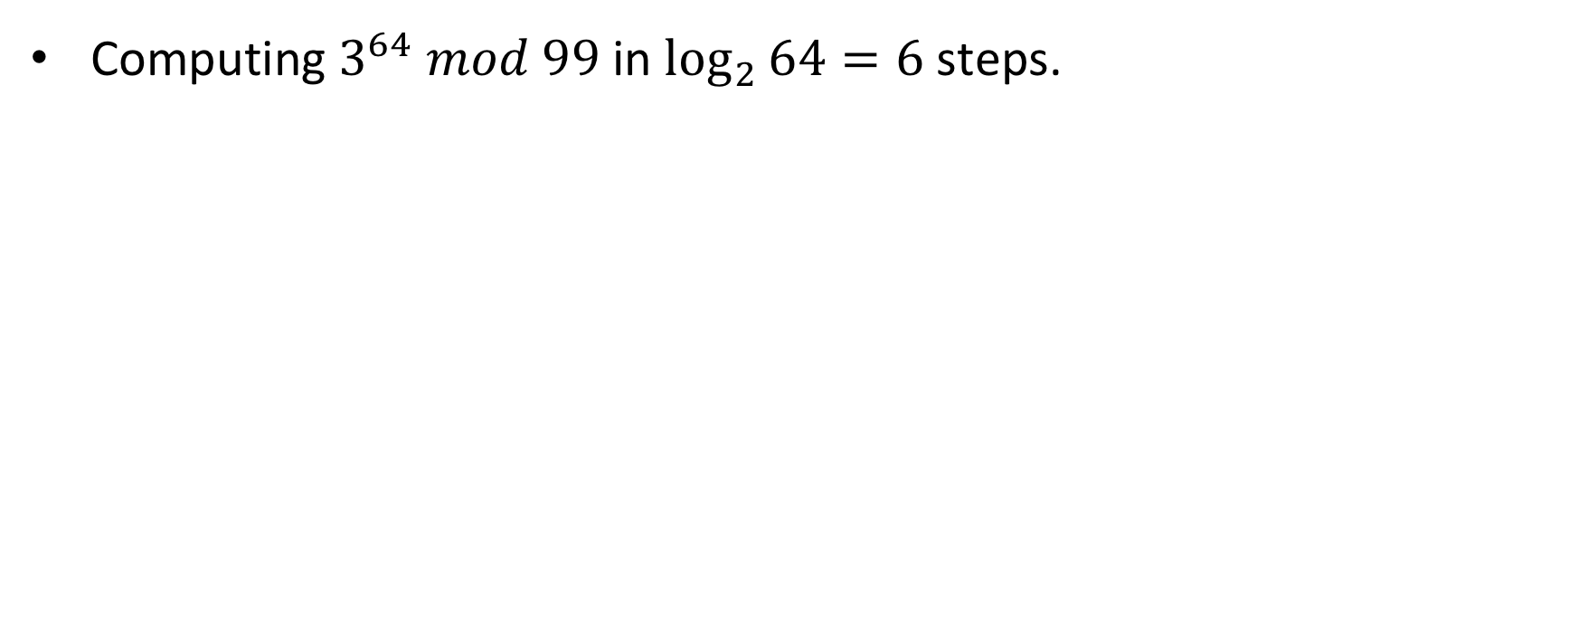
Example
Computing $3^{64} mod 99$ in $\log_{2}{64}=6$ steps.

Slide 32
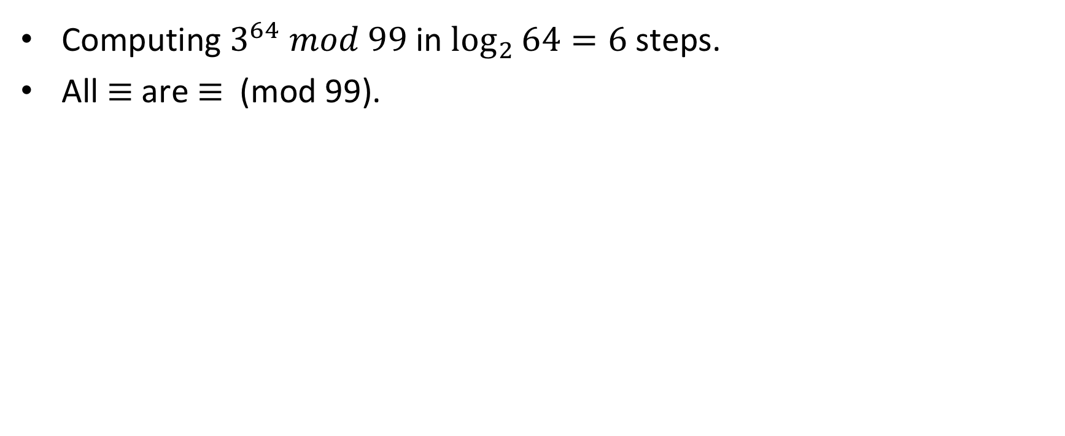
Example
Computing $3^{64} mod 99$ in $\log_{2}{64}=6$ steps.
All $≡$ are $≡$ (mod 99).

Slide 33
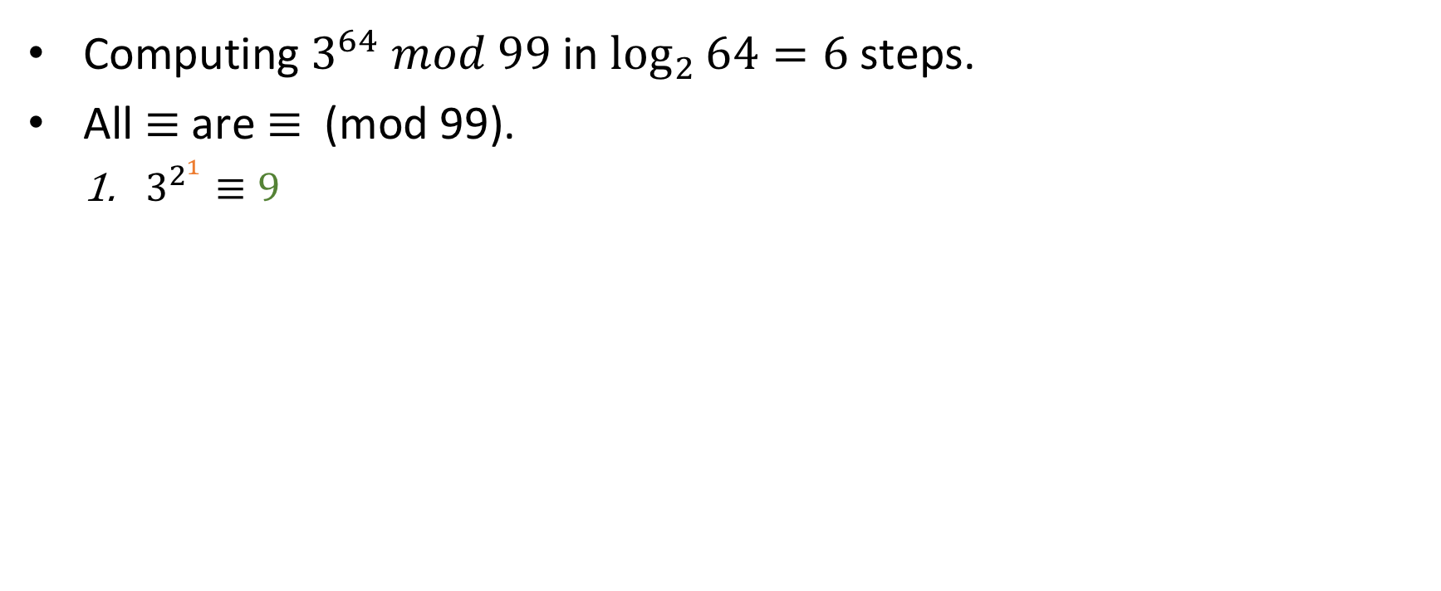
Example
Computing $3^{64} mod 99$ in $\log_{2}{64}=6$ steps.
All $≡$ are $≡$ (mod 99).
$3^{2^{1}}≡9$

Slide 34
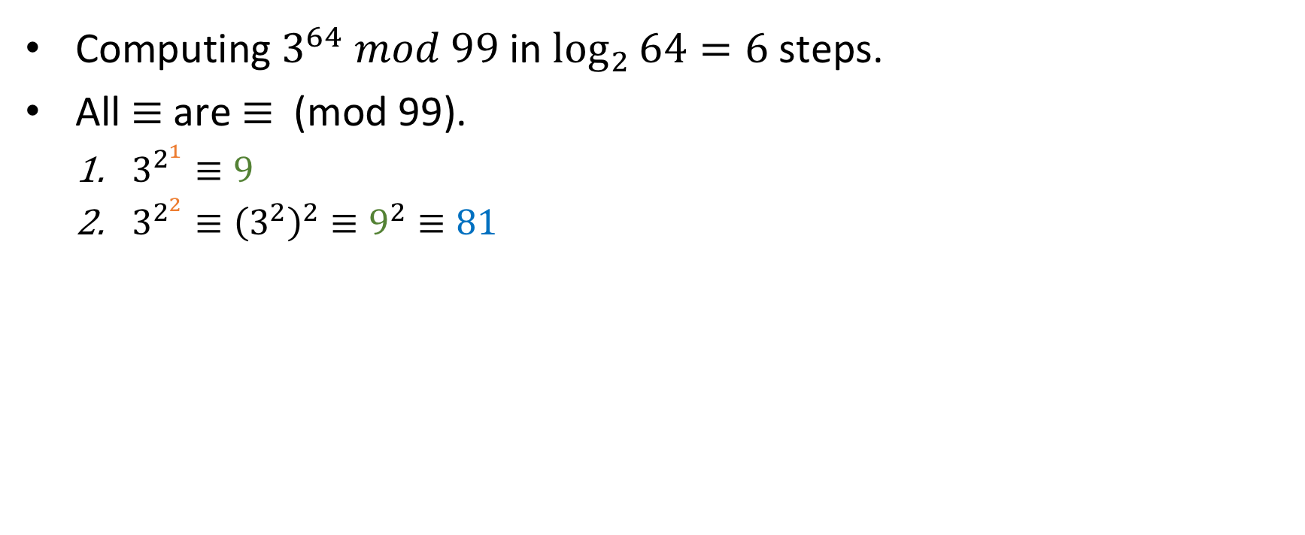
Example
Computing $3^{64} mod 99$ in $\log_{2}{64}=6$ steps.
All $≡$ are $≡$ (mod 99).
$3^{2^{1}}≡9$
$3^{2^{2}}≡{\left(3^{2}\right)}^{2}≡9^{2}≡81$

Slide 35
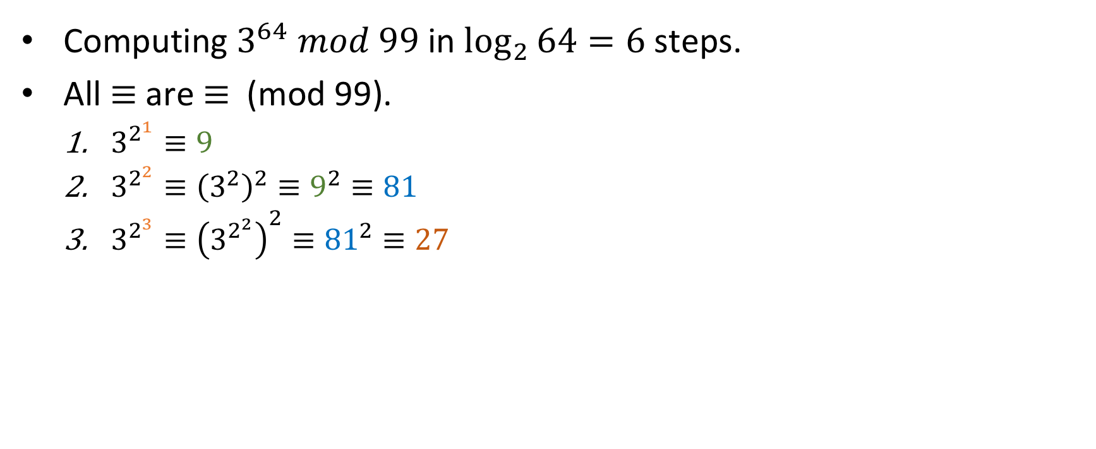
Example
Computing $3^{64} mod 99$ in $\log_{2}{64}=6$ steps.
All $≡$ are $≡$ (mod 99).
$3^{2^{1}}≡9$
$3^{2^{2}}≡{\left(3^{2}\right)}^{2}≡9^{2}≡81$
$3^{2^{3}}≡{\left(3^{2^{2}}\right)}^{2}≡{81}^{2}≡27$

Slide 36
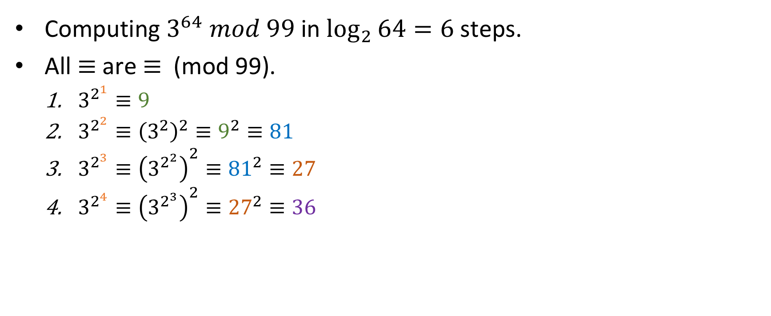
Example
Computing $3^{64} mod 99$ in $\log_{2}{64}=6$ steps.
All $≡$ are $≡$ (mod 99).
$3^{2^{1}}≡9$
$3^{2^{2}}≡{\left(3^{2}\right)}^{2}≡9^{2}≡81$
$3^{2^{3}}≡{\left(3^{2^{2}}\right)}^{2}≡{81}^{2}≡27$
$3^{2^{4}}≡{\left(3^{2^{3}}\right)}^{2}≡{27}^{2}≡36$

Slide 37
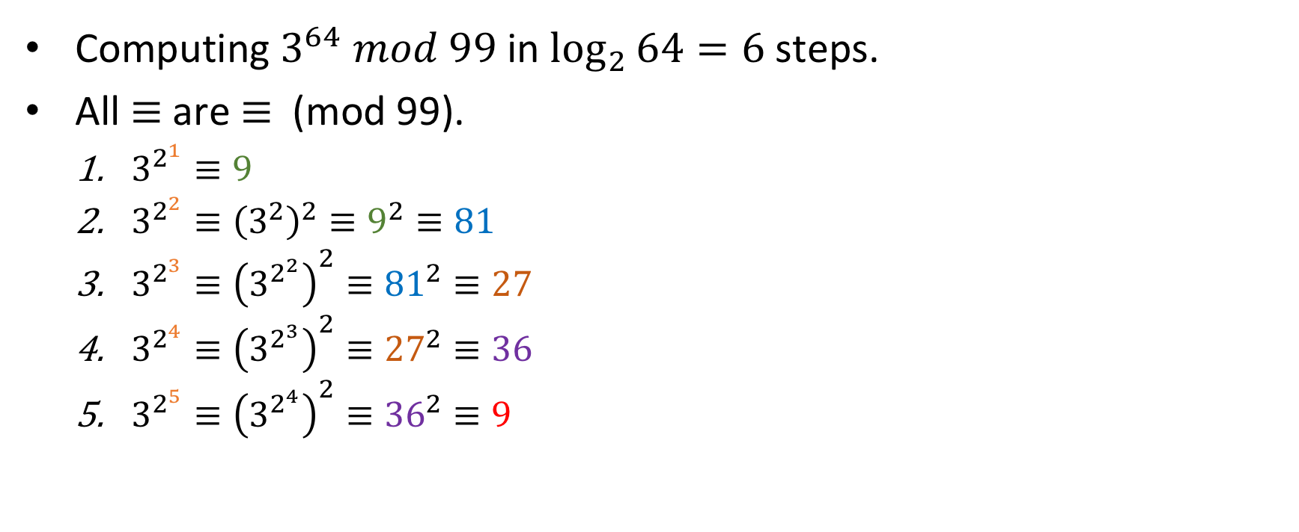
Example
Computing $3^{64} mod 99$ in $\log_{2}{64}=6$ steps.
All $≡$ are $≡$ (mod 99).
$3^{2^{1}}≡9$
$3^{2^{2}}≡{\left(3^{2}\right)}^{2}≡9^{2}≡81$
$3^{2^{3}}≡{\left(3^{2^{2}}\right)}^{2}≡{81}^{2}≡27$
$3^{2^{4}}≡{\left(3^{2^{3}}\right)}^{2}≡{27}^{2}≡36$
$3^{2^{5}}≡{\left(3^{2^{4}}\right)}^{2}≡{36}^{2}≡9$

Slide 38
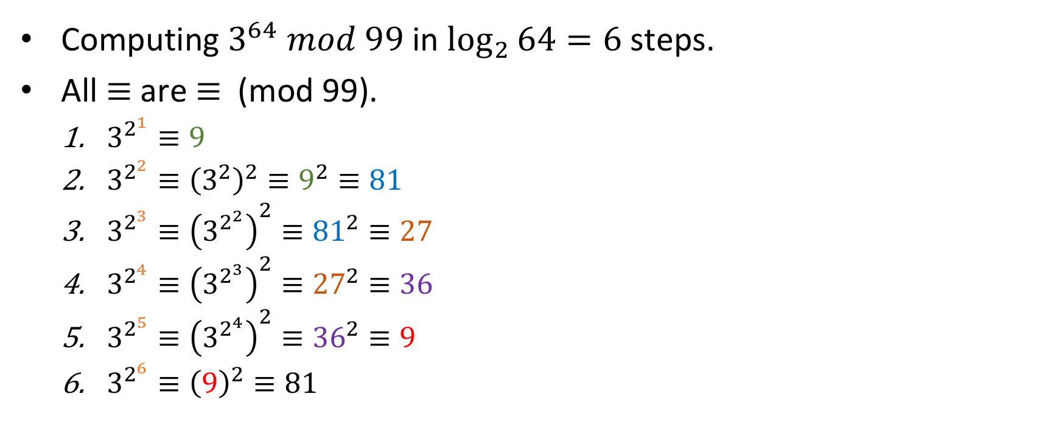
Example
Computing $3^{64} mod 99$ in $\log_{2}{64}=6$ steps.
All $≡$ are $≡$ (mod 99).
$3^{2^{1}}≡9$
$3^{2^{2}}≡{\left(3^{2}\right)}^{2}≡9^{2}≡81$
$3^{2^{3}}≡{\left(3^{2^{2}}\right)}^{2}≡{81}^{2}≡27$
$3^{2^{4}}≡{\left(3^{2^{3}}\right)}^{2}≡{27}^{2}≡36$
$3^{2^{5}}≡{\left(3^{2^{4}}\right)}^{2}≡{36}^{2}≡9$
$3^{2^{6}}≡{\left(9\right)}^{2}≡81$

Slide 39
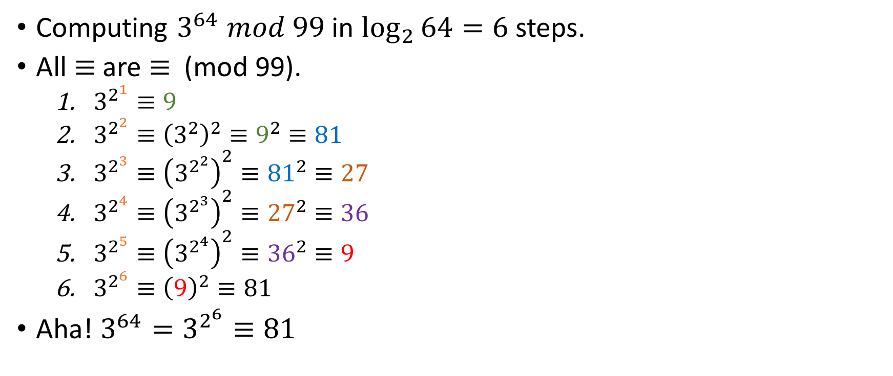
Example
Computing $3^{64} mod 99$ in $\log_{2}{64}=6$ steps.
All $≡$ are $≡$ (mod 99).
$3^{2^{1}}≡9$
$3^{2^{2}}≡{\left(3^{2}\right)}^{2}≡9^{2}≡81$
$3^{2^{3}}≡{\left(3^{2^{2}}\right)}^{2}≡{81}^{2}≡27$
$3^{2^{4}}≡{\left(3^{2^{3}}\right)}^{2}≡{27}^{2}≡36$
$3^{2^{5}}≡{\left(3^{2^{4}}\right)}^{2}≡{36}^{2}≡9$
$3^{2^{6}}≡{\left(9\right)}^{2}≡81$
Aha! ${3^{64}=3}^{2^{6}}≡81$

Slide 40
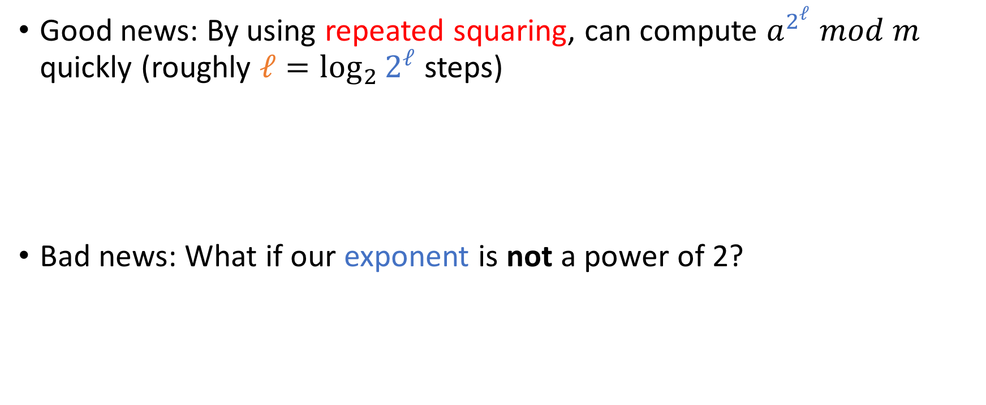
Good news, bad news
Good news: By using repeated squaring, can compute $a^{2^{ℓ}} mod m$ quickly (roughly $ℓ=\log_{2}{2^{ℓ}}$ steps)
Bad news: What if our exponent is not a power of 2?

Slide 41
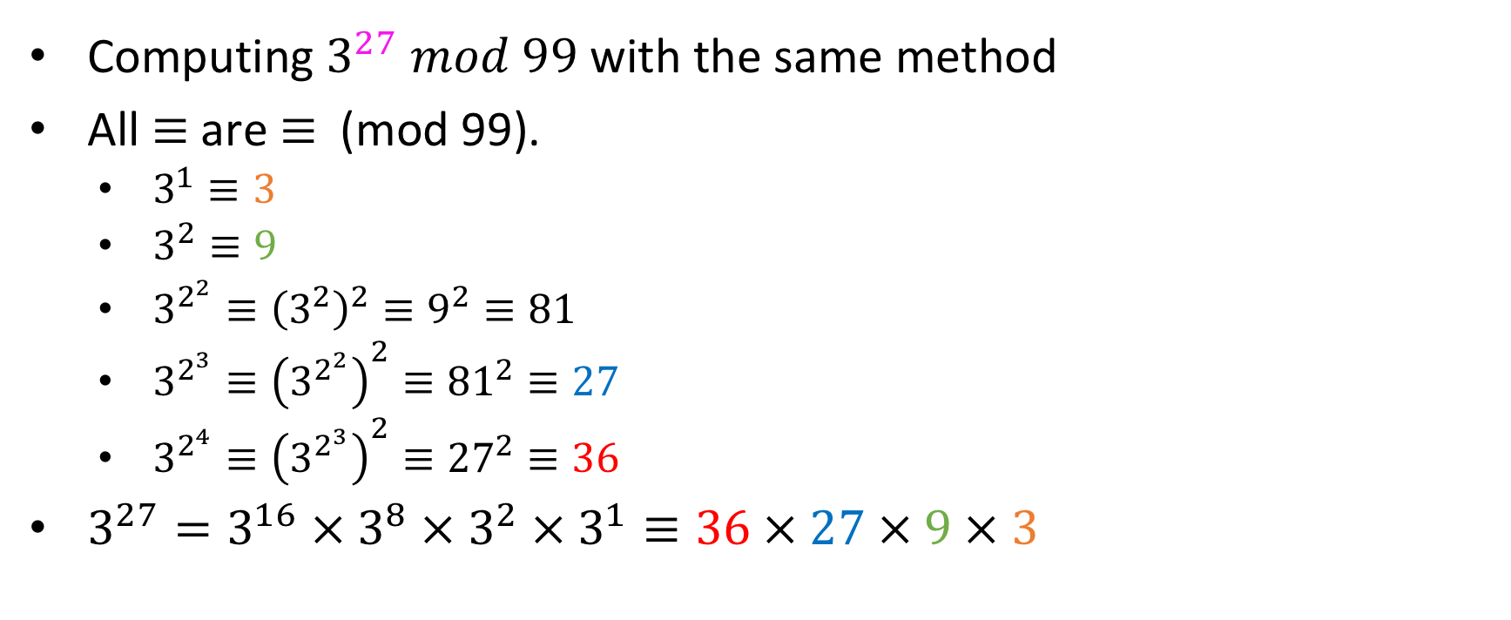
Example
Computing $3^{27} mod 99$ with the same method
All $≡$ are $≡$ (mod 99).
$3^{1}≡3$
$3^{2}≡9$
$3^{2^{2}}≡{\left(3^{2}\right)}^{2}≡9^{2}≡81$
$3^{2^{3}}≡{\left(3^{2^{2}}\right)}^{2}≡{81}^{2}≡27$
$3^{2^{4}}≡{\left(3^{2^{3}}\right)}^{2}≡{27}^{2}≡36$
$3^{27}=3^{16} × 3^{8} × 3^{2} × 3^{1}≡36 × 27 × 9 × 3$

Slide 42
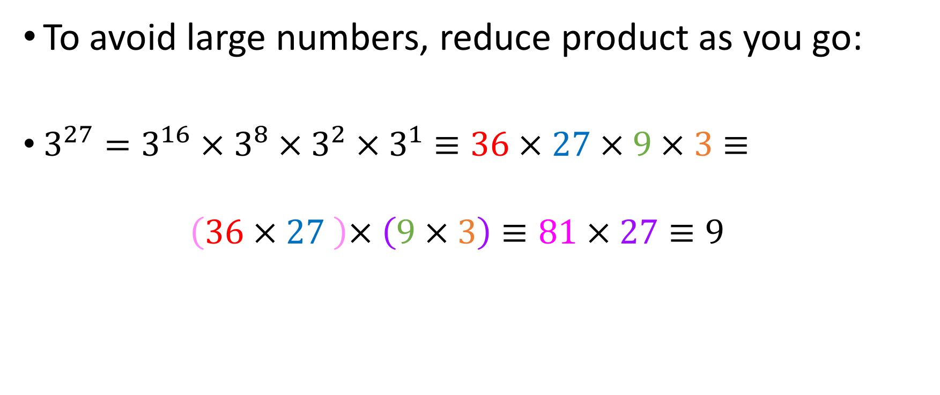
Example (contd.)
To avoid large numbers, reduce product as you go:
$3^{27}=3^{16} × 3^{8} × 3^{2} × 3^{1}≡36 × 27 × 9 × 3≡$
$$\left(36 × 27 \right)× \left(9 × 3\right)≡81 × 27≡9$$

Slide 43
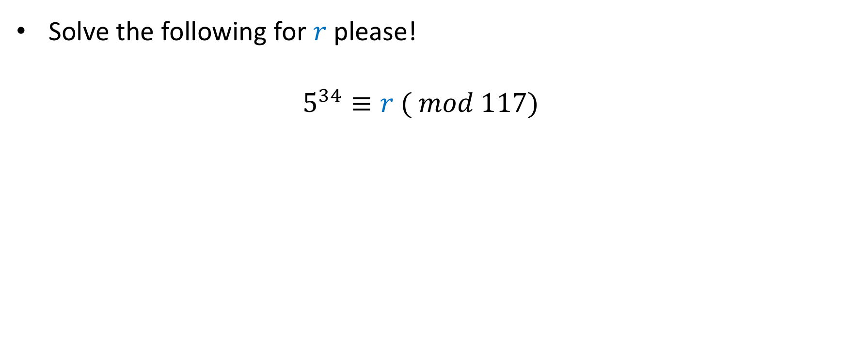
Exercise
Solve the following for $r$ please!
$$5^{34}≡r ( mod 117)$$

Slide 44
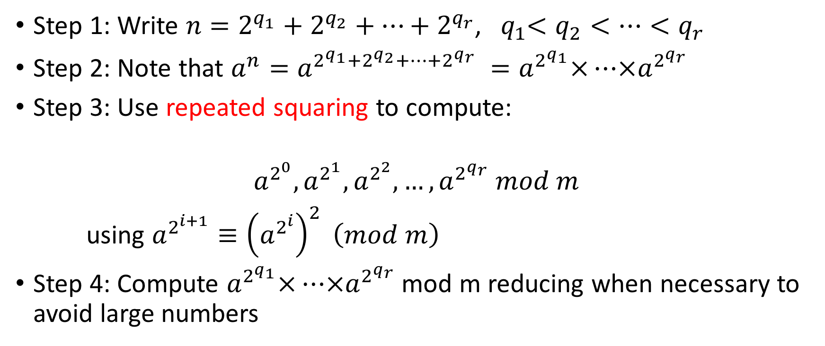

Algorithm to compute $a^{n} \left(mod m\right)$ in log$n$ steps
Step 1: Write $n=2^{q_{1}}+2^{q_{2}}+…+2^{q_{r}}$, ${ q}_{1}<q_{2}<…<q_{r}$
Step 2: Note that $a^{n}=a^{2^{q_{1}}+2^{q_{2}}+…+2^{q_{r}} }=a^{2^{q_{1}}}×…×a^{2^{q_{r}}}$
Step 3: Use repeated squaring to compute:
$$a^{2^{0}}, a^{2^{1}},a^{2^{2}}, …, a^{2^{q_{r}}} mod m$$
using $a^{2^{i+1}}≡{\left(a^{2^{i}}\right)}^{2} \left(mod m\right)$
Step 4: Compute $a^{2^{q_{1}}}×…×a^{2^{q_{r}}}$ mod m reducing when necessary to avoid large numbers

Slide 45
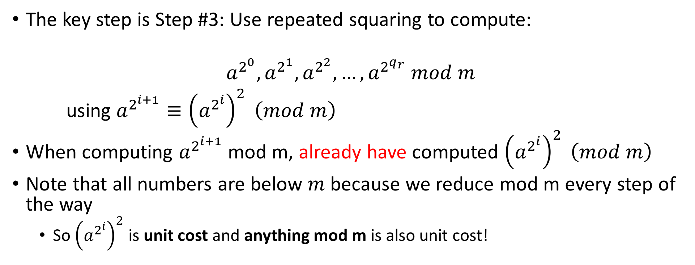
The key step
The key step is Step #3: Use repeated squaring to compute:
$$a^{2^{0}}, a^{2^{1}},a^{2^{2}}, …, a^{2^{q_{r}}} mod m$$
using $a^{2^{i+1}}≡{\left(a^{2^{i}}\right)}^{2} \left(mod m\right)$
When computing $a^{2^{i+1}}$ mod m, already have computed ${\left(a^{2^{i}}\right)}^{2} \left(mod m\right)$
Note that all numbers are below $m$ because we reduce mod m every step of the way
So ${\left(a^{2^{i}}\right)}^{2}$ is unit cost and anything mod m is also unit cost!

Slide 46
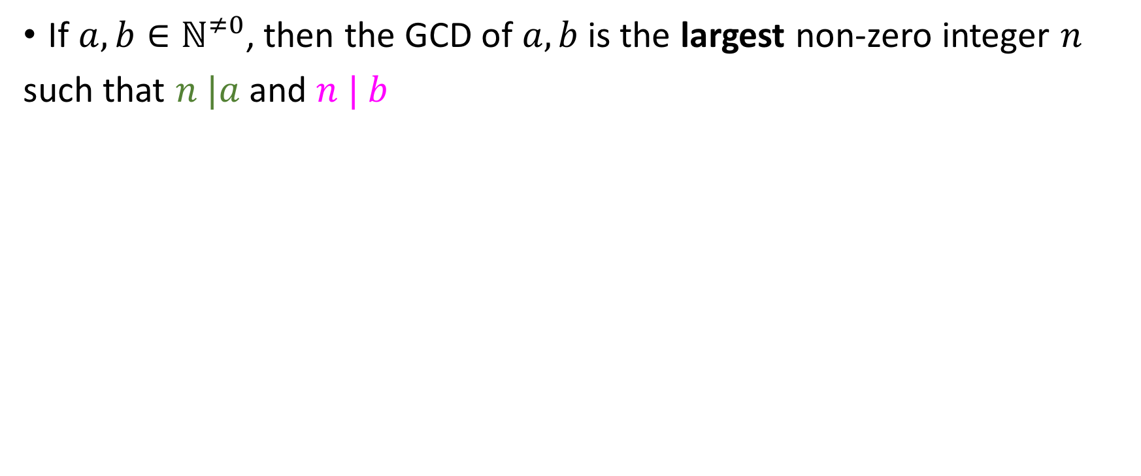
Second problem: Greatest Common Divisor (GCD)
If $a, b∈ℕ^{≠0}$, then the GCD of $a, b$ is the largest non-zero integer $n$
such that $n |a$and $n | b$

Slide 47
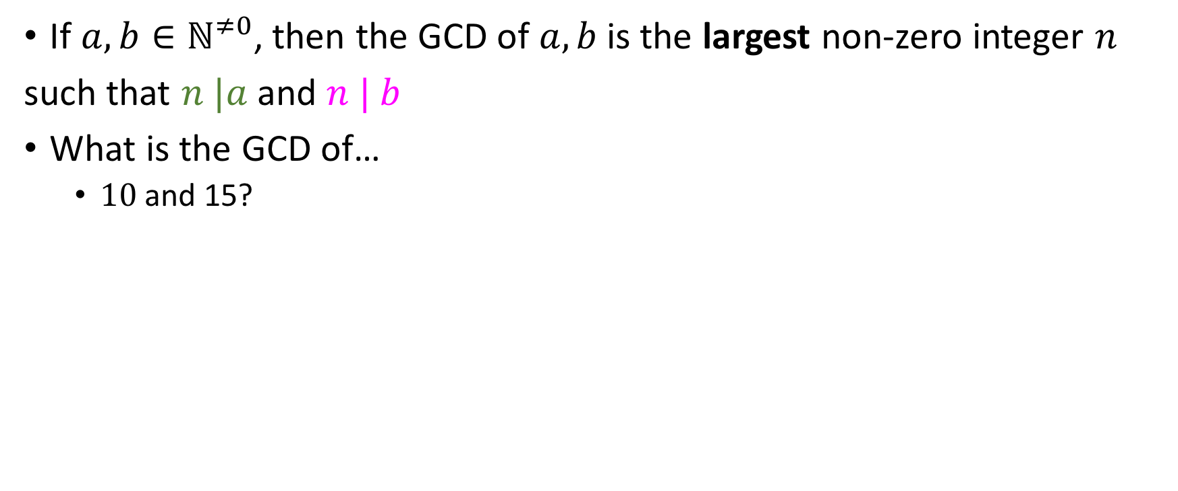
Second problem: Greatest Common Divisor (GCD)
If $a, b∈ℕ^{≠0}$, then the GCD of $a, b$ is the largest non-zero integer $n$
such that $n |a$and $n | b$
What is the GCD of…
$10$ and 15?

Slide 48
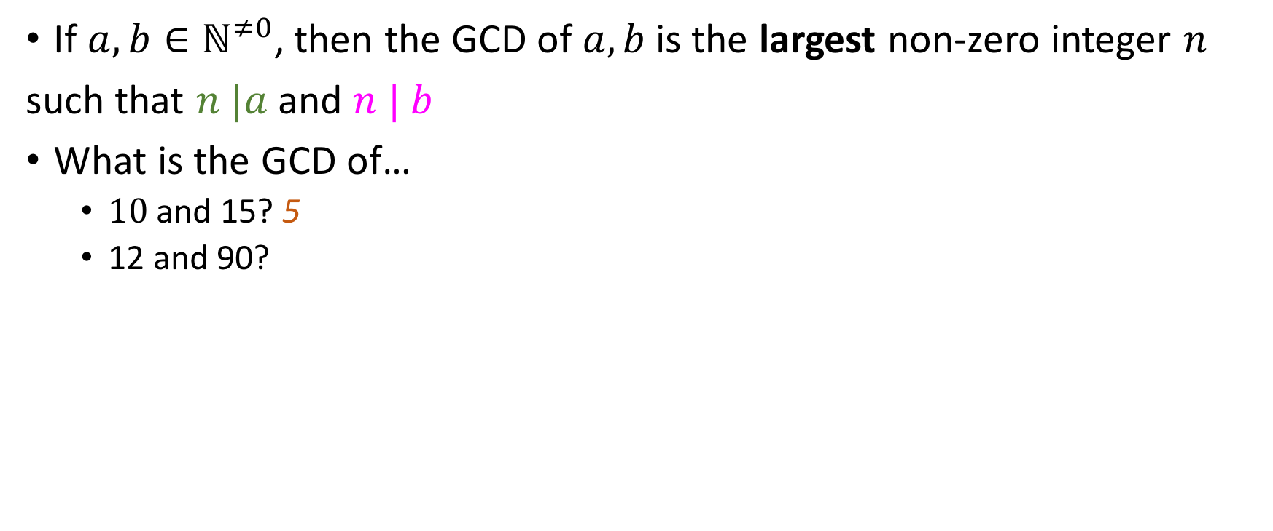
Second problem: Greatest Common Divisor (GCD)
If $a, b∈ℕ^{≠0}$, then the GCD of $a, b$ is the largest non-zero integer $n$
such that $n |a$and $n | b$
What is the GCD of…
$10$ and 15? 5
12 and 90?

Slide 49
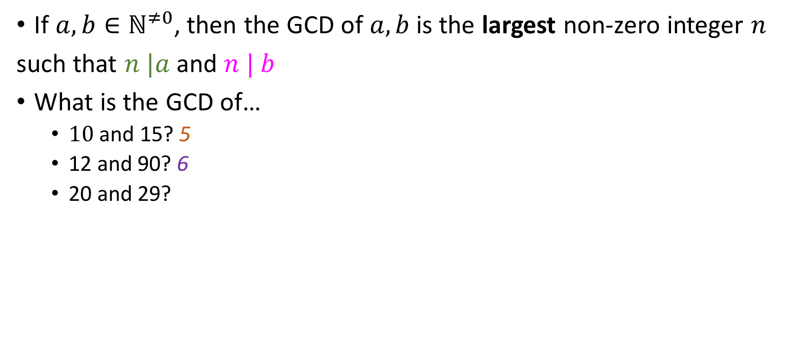
Second problem: Greatest Common Divisor (GCD)
If $a, b∈ℕ^{≠0}$, then the GCD of $a, b$ is the largest non-zero integer $n$
such that $n |a$and $n | b$
What is the GCD of…
$10$ and 15? 5
12 and 90? 6
20 and 29?

Slide 50
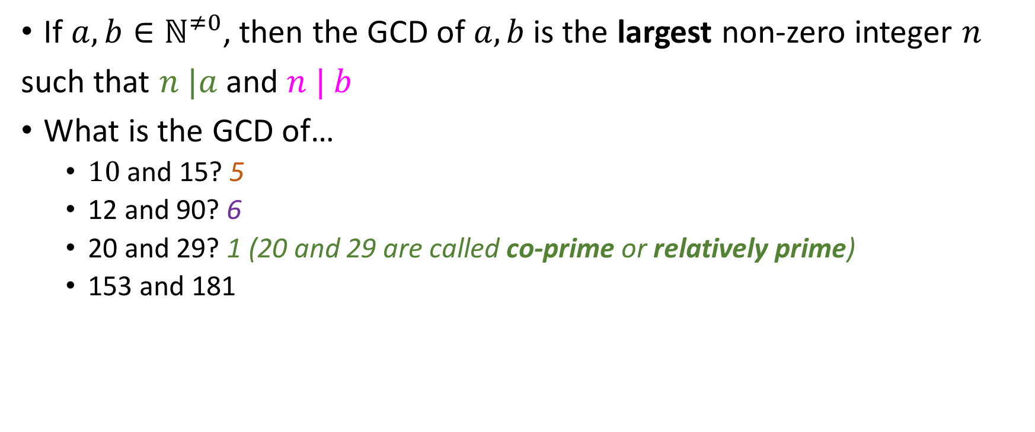
Second problem: Greatest Common Divisor (GCD)
If $a, b∈ℕ^{≠0}$, then the GCD of $a, b$ is the largest non-zero integer $n$
such that $n |a$and $n | b$
What is the GCD of…
$10$ and 15? 5
12 and 90? 6
20 and 29? 1 (20 and 29 are called co-prime or relatively prime)
153 and 181

Slide 51
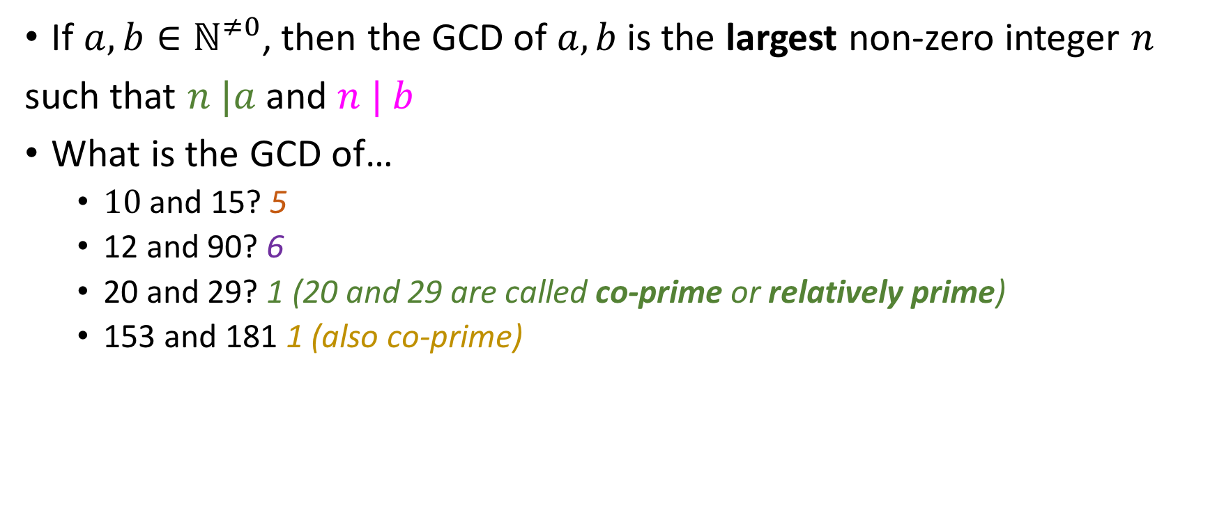
Second problem: Greatest Common Divisor (GCD)
If $a, b∈ℕ^{≠0}$, then the GCD of $a, b$ is the largest non-zero integer $n$
such that $n |a$and $n | b$
What is the GCD of…
$10$ and 15? 5
12 and 90? 6
20 and 29? 1 (20 and 29 are called co-prime or relatively prime)
153 and 181 1 (also co-prime)

Slide 52

Euclid’s GCD algorithm
Recall: If $a≡0 (mod m)$ and $b≡0 \left(mod m\right),$then $a −b≡\left(0 mod m\right)$
The GCD algorithm finds the greatest common divisor by executing this recursion (assume a > b):
$$GCD\left(a, b\right)=GCD\left(a, b −a\right)$$
Until its arguments are the same.

Slide 53

Greatest Common Divisor (GCD)
Recall: If $a≡0 (mod m)$ and $b≡0 \left(mod m\right),$then $a −b≡\left(0 mod m\right)$
The GCD algorithm finds the greatest common divisor by executing this recursion (assume a > b):
$$GCD\left(a, b\right)=GCD\left(a, b −a\right)$$
Until its arguments are the same.
Question: If we implement this in a programming language, it can only be done recursively
Yes (why)
No (Why)
Something Else (What)

Slide 54

Greatest Common Divisor (GCD)
Recall: If $a≡0 (mod m)$ and $b≡0 \left(mod m\right),$then $a −b≡\left(0 mod m\right)$
The GCD algorithm finds the greatest common divisor by executing this recursion (assume a > b):
$$GCD\left(a, b\right)=GCD\left(a, b −a\right)$$
Until its arguments are the same.
Question: If we implement this in a programming language, it can only be done recursively
Tail recursion
left = a; right = b; while(left != right){
if(left > right)
left = left – right; else right = right - left; } print "GCD is: " left; // Or right
Yes (why)
No (Why)
Something Else (What)

Slide 55
GCD example
GCD(18, 100) =
GCD(18, 100 – 18) = GCD(18, 82)=
GCD(18, 82 – 18 = GCD(18, 64) =
GCD(18, 64 – 18) = GCD(18, 46) =
GCD(18, 46 – 18) = GCD(18, 28) =
GCD(18, 28 – 18) = GCD(18, 10) =
GCD(18 - 10, 10) = GCD(8, 10)=
GCD(8, 10 - 8)= GCD(8, 2) =
GCD(8 - 2, 2) = GCD(6, 2) =
GCD(6 - 2, 2) = GCD(4, 2) =
GCD(4- 2, 2) = GCD(2, 2) = 2

Slide 56

GCD example
GCD(18, 100) =
GCD(18, 100 – 18) = GCD(18, 82)=
GCD(18, 82 – 18 = GCD(18, 64) =
GCD(18, 64 – 18) = GCD(18, 46) =
GCD(18, 46 – 18) = GCD(18, 28) =
GCD(18, 28 – 18) = GCD(18, 10) =
GCD(18 - 10, 10) = GCD(8, 10)=
GCD(8, 10 - 8)= GCD(8, 2) =
GCD(8 - 2, 2) = GCD(6, 2) =
GCD(6 - 2, 2) = GCD(4, 2) =
GCD(4- 2, 2) = GCD(2, 2) = 2
Given integers $a, b$ with $a>b$ (without loss of generality), approximately how many steps does this algorithm take?
a steps
b steps
a-b steps
Something Else

Slide 57

GCD example
GCD(18, 100) =
GCD(18, 100 – 18) = GCD(18, 82)=
GCD(18, 82 – 18 = GCD(18, 64) =
GCD(18, 64 – 18) = GCD(18, 46) =
GCD(18, 46 – 18) = GCD(18, 28) =
GCD(18, 28 – 18) = GCD(18, 10) =
GCD(18 - 10, 10) = GCD(8, 10)=
GCD(8, 10 - 8)= GCD(8, 2) =
GCD(8 - 2, 2) = GCD(6, 2) =
GCD(6 - 2, 2) = GCD(4, 2) =
GCD(4- 2, 2) = GCD(2, 2) = 2
Given integers $a, b$ with $a>b$ (without loss of generality), approximately how many steps does this algorithm take?
a steps
b steps
Something Else
Roughly
$$a/b$$
a-b steps

Slide 58
Can we do better?
Yes
No
Something Else
GCD(18, 100) =
GCD(18, 100 – 18) = GCD(18, 82)=
GCD(18, 82 – 18 = GCD(18, 64) =
GCD(18, 64 – 18) = GCD(18, 46) =
GCD(18, 46 – 18) = GCD(18, 28) =
GCD(18, 28 – 18) = GCD(18, 10) =
GCD(18 - 10, 10) = GCD(8, 10)=
GCD(8, 10 - 8)= GCD(8, 2) =
GCD(8 - 2, 2) = GCD(6, 2) =
GCD(6 - 2, 2) = GCD(4, 2) =
GCD(4- 2, 2) = GCD(2, 2) = 2

Slide 59
Can we do better?
Yes
No
Something Else
GCD(18, 100) =
GCD(18, 100 – 18) = GCD(18, 82)=
GCD(18, 82 – 18) = GCD(18, 64) =
GCD(18, 64 – 18) = GCD(18, 46) =
GCD(18, 46 – 18) = GCD(18, 28) =
GCD(18, 28 – 18) = GCD(18, 10) =
GCD(18 - 10, 10) = GCD(8, 10)=
GCD(8, 10 - 8)= GCD(8, 2) =
GCD(8 - 2, 2) = GCD(6, 2) =
GCD(6 - 2, 2) = GCD(4, 2) =
GCD(4- 2, 2) = GCD(2, 2) = 2
GCD(18, 100 – 5 x 18)
GCD(18, 100) =
GCD(18, 100 – 5 x 18) = GCD(18, 10) =
GCD(18 – 10, 10) = GCD(8, 10) =
GCD(8, 10 - 8) = GCD(8, 2) =
GCD(8 – 3 x 2, 2) = GCD(2, 2) = 2
GCD(8 – 3 x 2, 2)
From 10 to 4 steps!

Slide 60




How fast is this new algorithm?
Given non-zero integers $a, b$ with $a > b$, roughly how many steps does this new algorithm take to compute GCD(a, b)?
$$a/{b^{2}}$$
$$\sqrt{a}$$
$$\log_{2}{a}$$
Something Else

Slide 61

How fast is this new algorithm?
Given non-zero integers $a, b$ with $a > b$, roughly how many steps does this new algorithm take to compute GCD(a, b)?
In fact, it takes $\log_{φ}{a}$, where $φ=\frac{1+\sqrt{5}}{2}$ is the golden ratio.
Proof by Gabriel Lamé in 1844, considered by some to be the first ever result in Algorithmic Complexity theory.
$$a/{b^{2}}$$
$$\sqrt{a}$$
$$\log_{2}{a}$$
Something Else

